Slide 1
Tdc meeting
2.17.21
preliminary super bowl lv recap

Slide 2

STR hotel performance
Friday, Feb. 5
  68.3% occupancy (-20.8% YOY)
  $191.09 ADR (+13.3% YOY)
  Third highest ADR since March 14, 2020 (July 4 was $191.87)
Saturday, Feb. 6
  81.1% occupancy (-8% YOY)
  $202.62 ADR (+21.5%)
  Highest ADR since March 14
Sunday, Feb. 7
  TBD, receive today

Slide 3
Keydata vacation rental performance
Friday, Feb. 5
  80% occupancy (-8% YOY)
  $208 ADR (+9.4% YOY)
Saturday, Feb. 6
  85% occupancy (-3.5% YOY)
  $214 ADR (+9.2%)
Sunday, Feb. 7
  81.1.% occupancy (-5% YOY)
  $214 ADR (+9.3%)
84% weekly occupancy was highest since early March 2020

Slide 4
 | Prior to SB LV Weekend (90-days) | SB LV Weekend | Change over non-Super Bowl Weekend
Hotel Occupancy (nightly) | 46% - 58% | 68% - 81% | + 22% - 23%
Hotel ADR (nightly) | $109 - $133 | $191 - $202 | + $69 - $82
Vacation Rentals Occupancy (nightly) | 50% - 74% | 80% - 85% | +11% - 30%
Vacation Rentals ADR (nightly) | $144 - $189 | $208 - $214 | + $25 - $64

Slide 5
MEDIA COVERAGE BY THE NUMBERS
899 placements (472 broadcast, 325 online including syndication, 92 radio)
More than 1 billion impressions
Ad-value equivalency of $24,678,343
Reached 49 states and 245 cities across the U.S.
Topics:
  General hosting/impacts/safety
  Nick’s pick
  Gulp Coast (Green Bench Brewery, etc.)
  Things to do (beaches, St. Pete Pier)
  St. Pete Shuffleboard Club

Slide 6
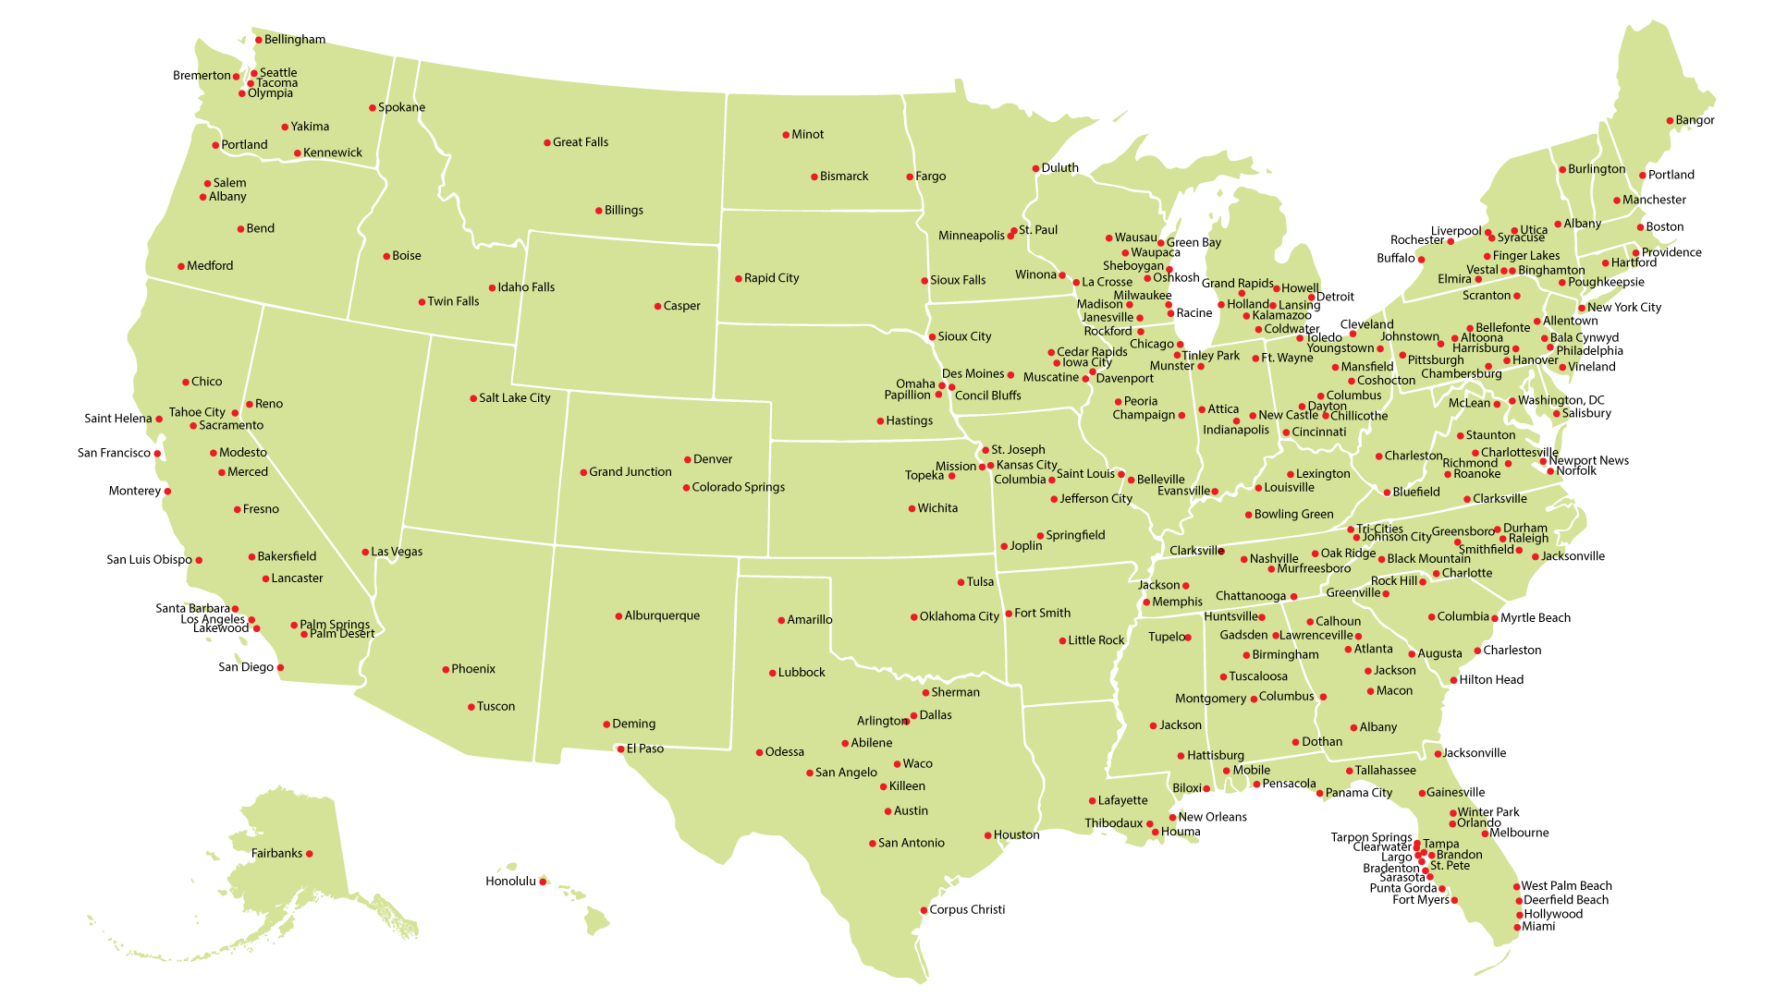

Slide 7

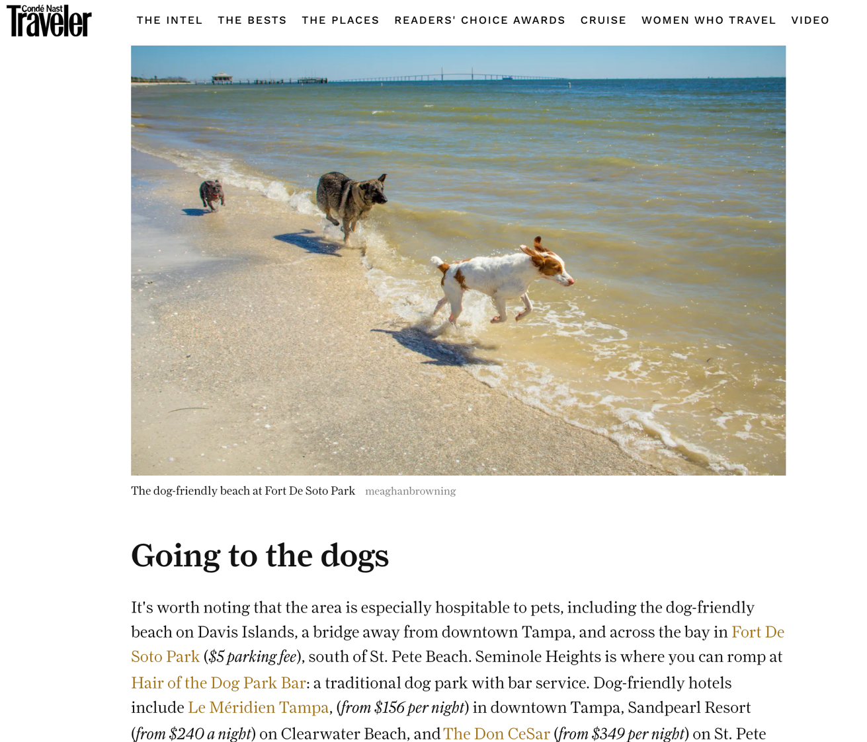
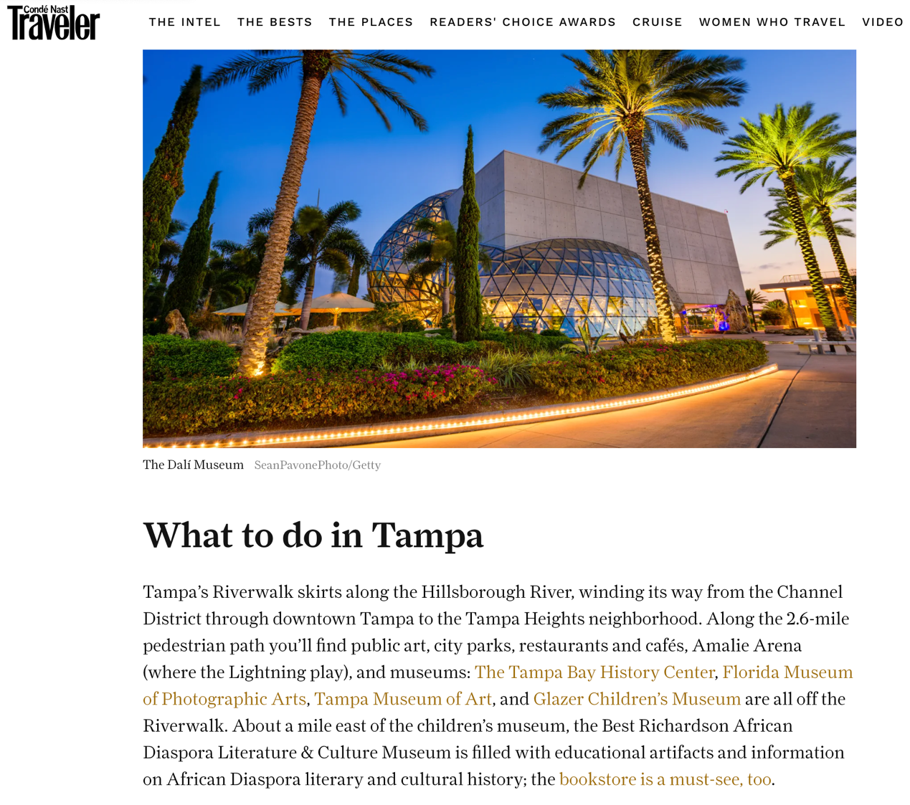

Slide 8


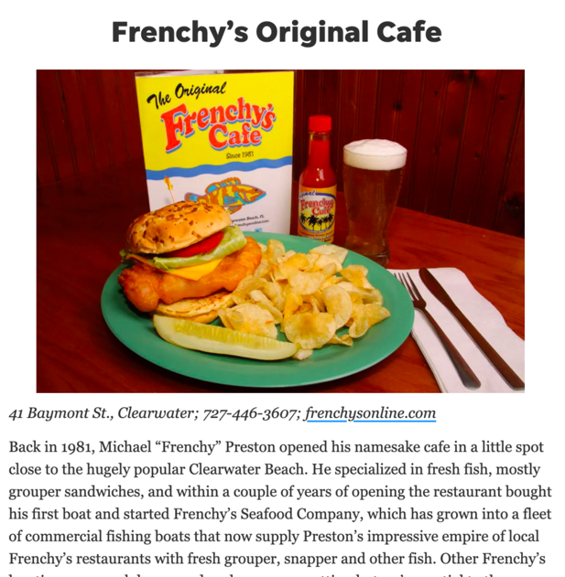
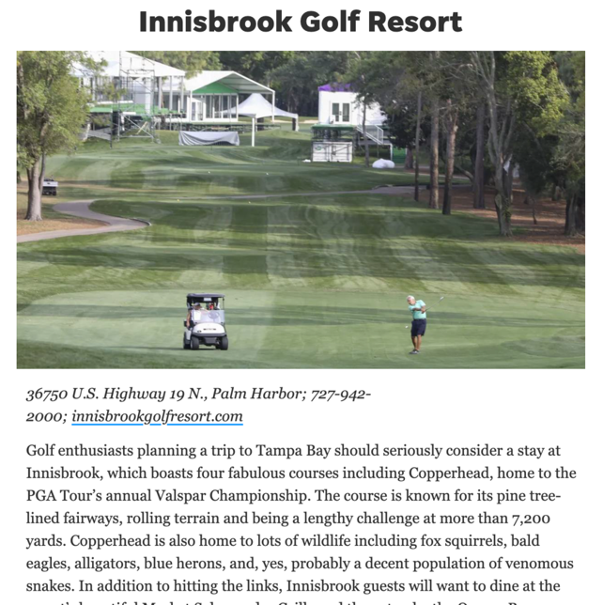

Slide 9
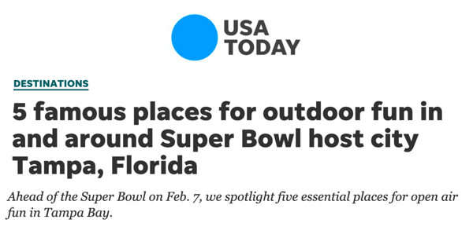
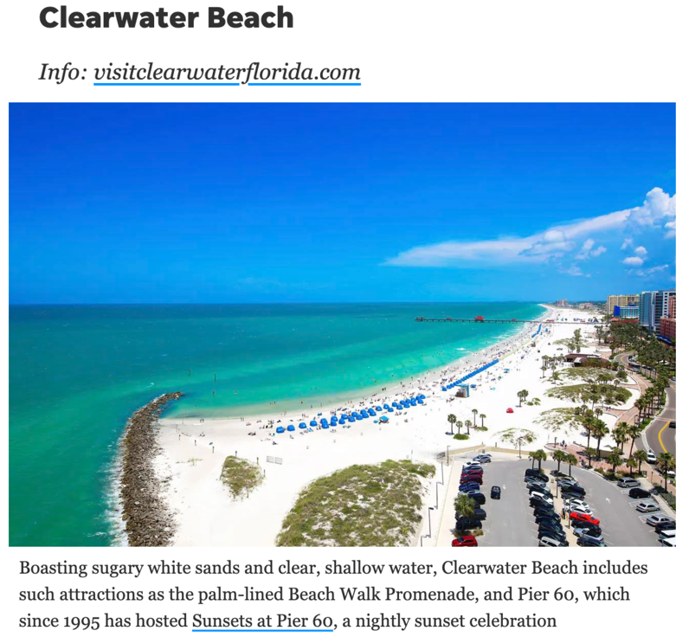
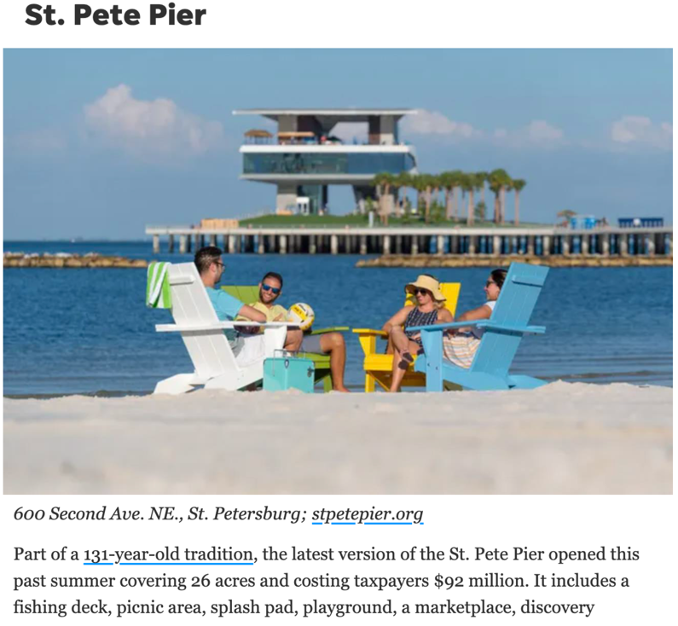

Slide 10
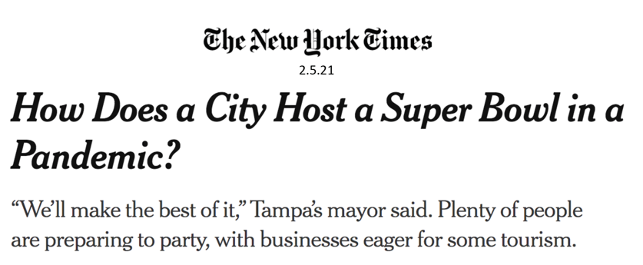
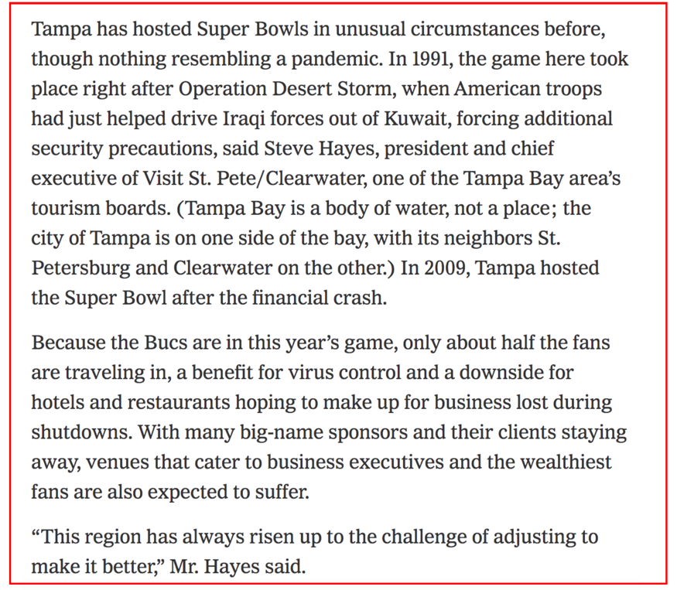
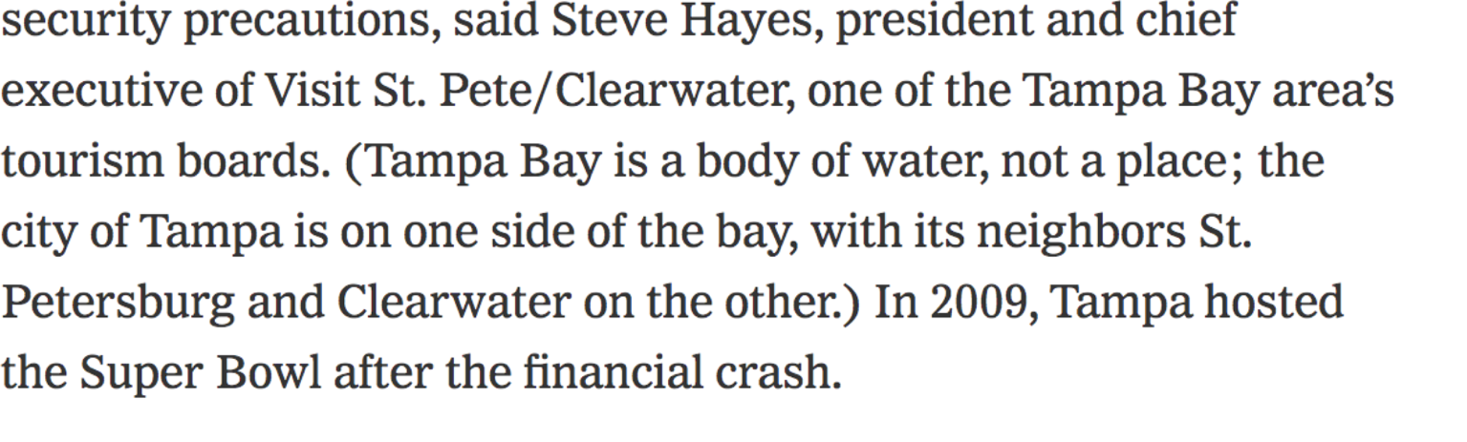

Slide 11

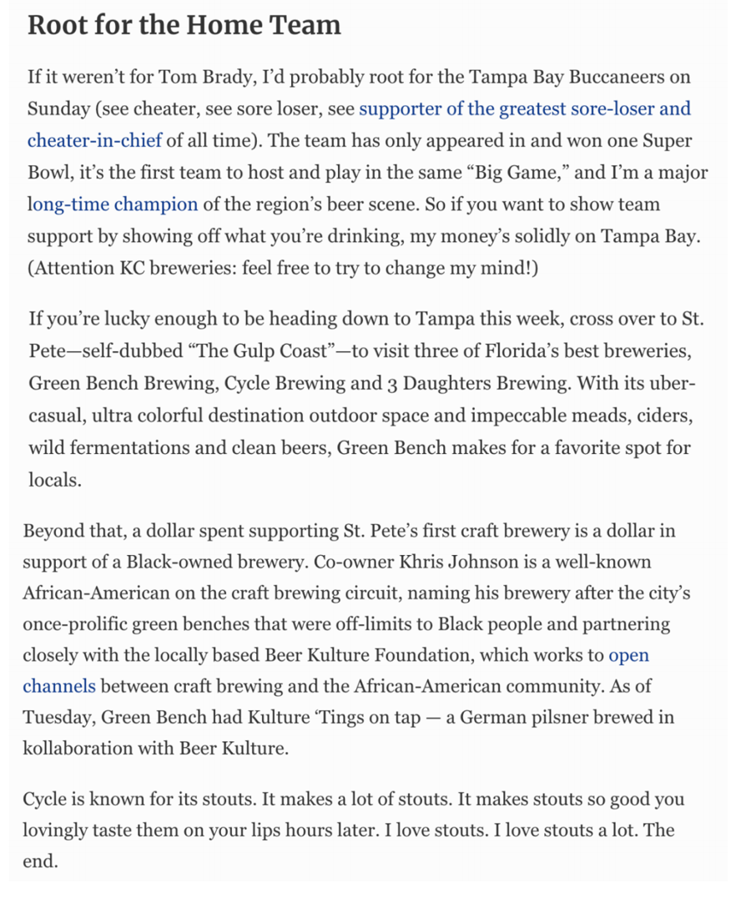
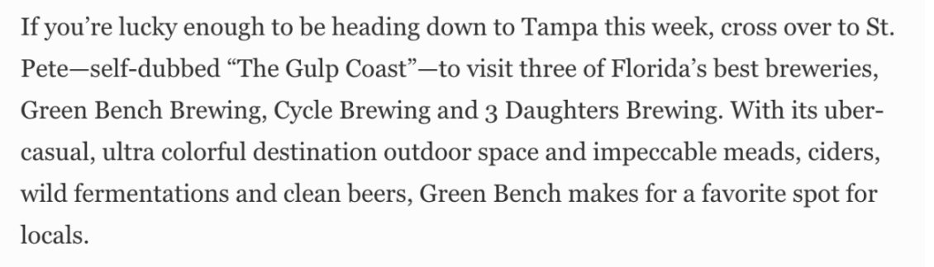

Slide 12
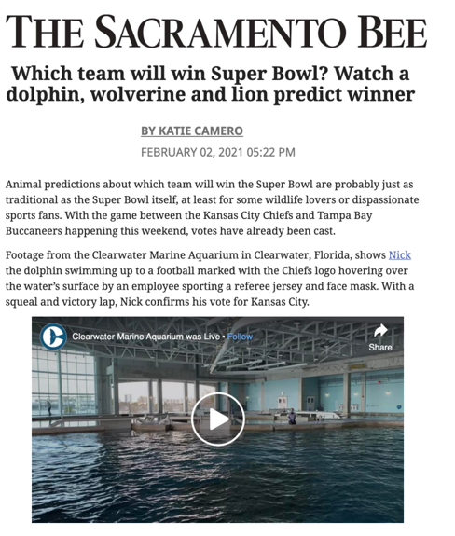
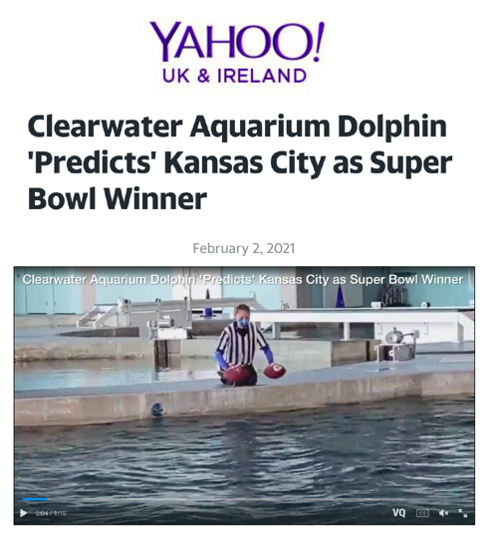
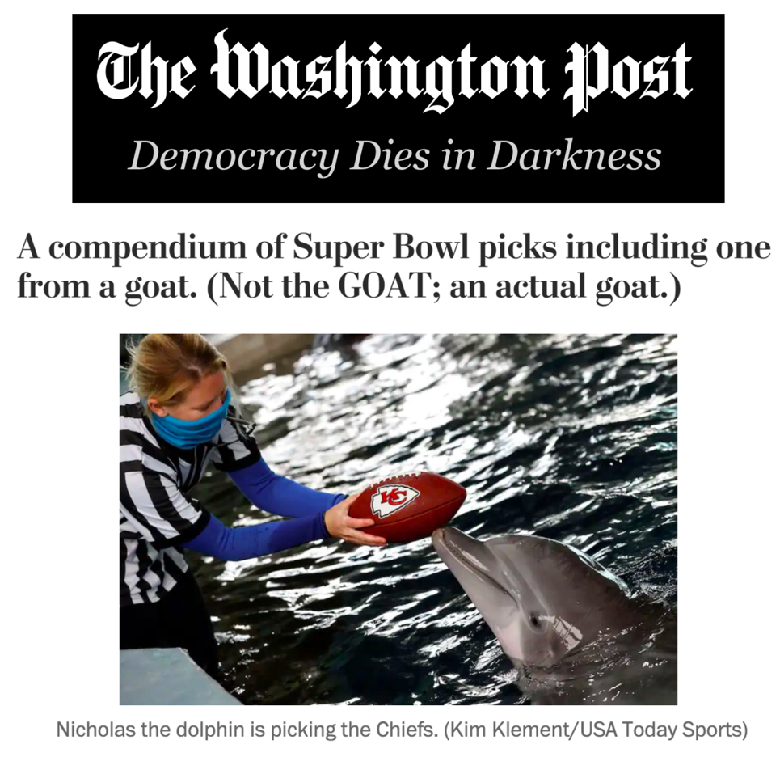
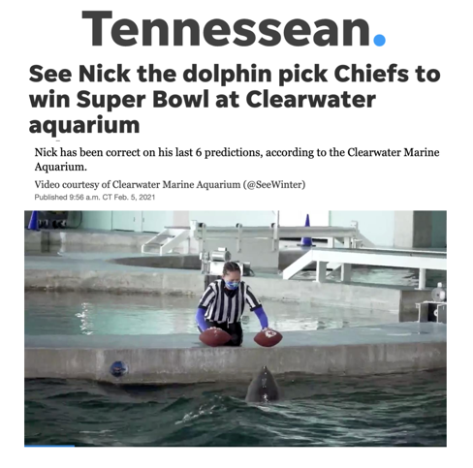

Slide 13
BROADCAST EXPOSURE
ESPN Super Bowl coverage originated from TradeWinds on St. Pete Beach from Thursday-Sunday
  Beach footage used in-and-out of commercial
Celebrity Sweat Flag Football Game live and taped from Clearwater Beach
  Aired live on ESPNNews
  Airs taped on FoxSports Florida and Sun Network
Estimated combined media value for destination exposure of $186,485

Slide 14

Super bowl LV
Data from destination analysts’
Coronavirus travel sentiment index study
data collected February 12-14, 2021

Slide 15
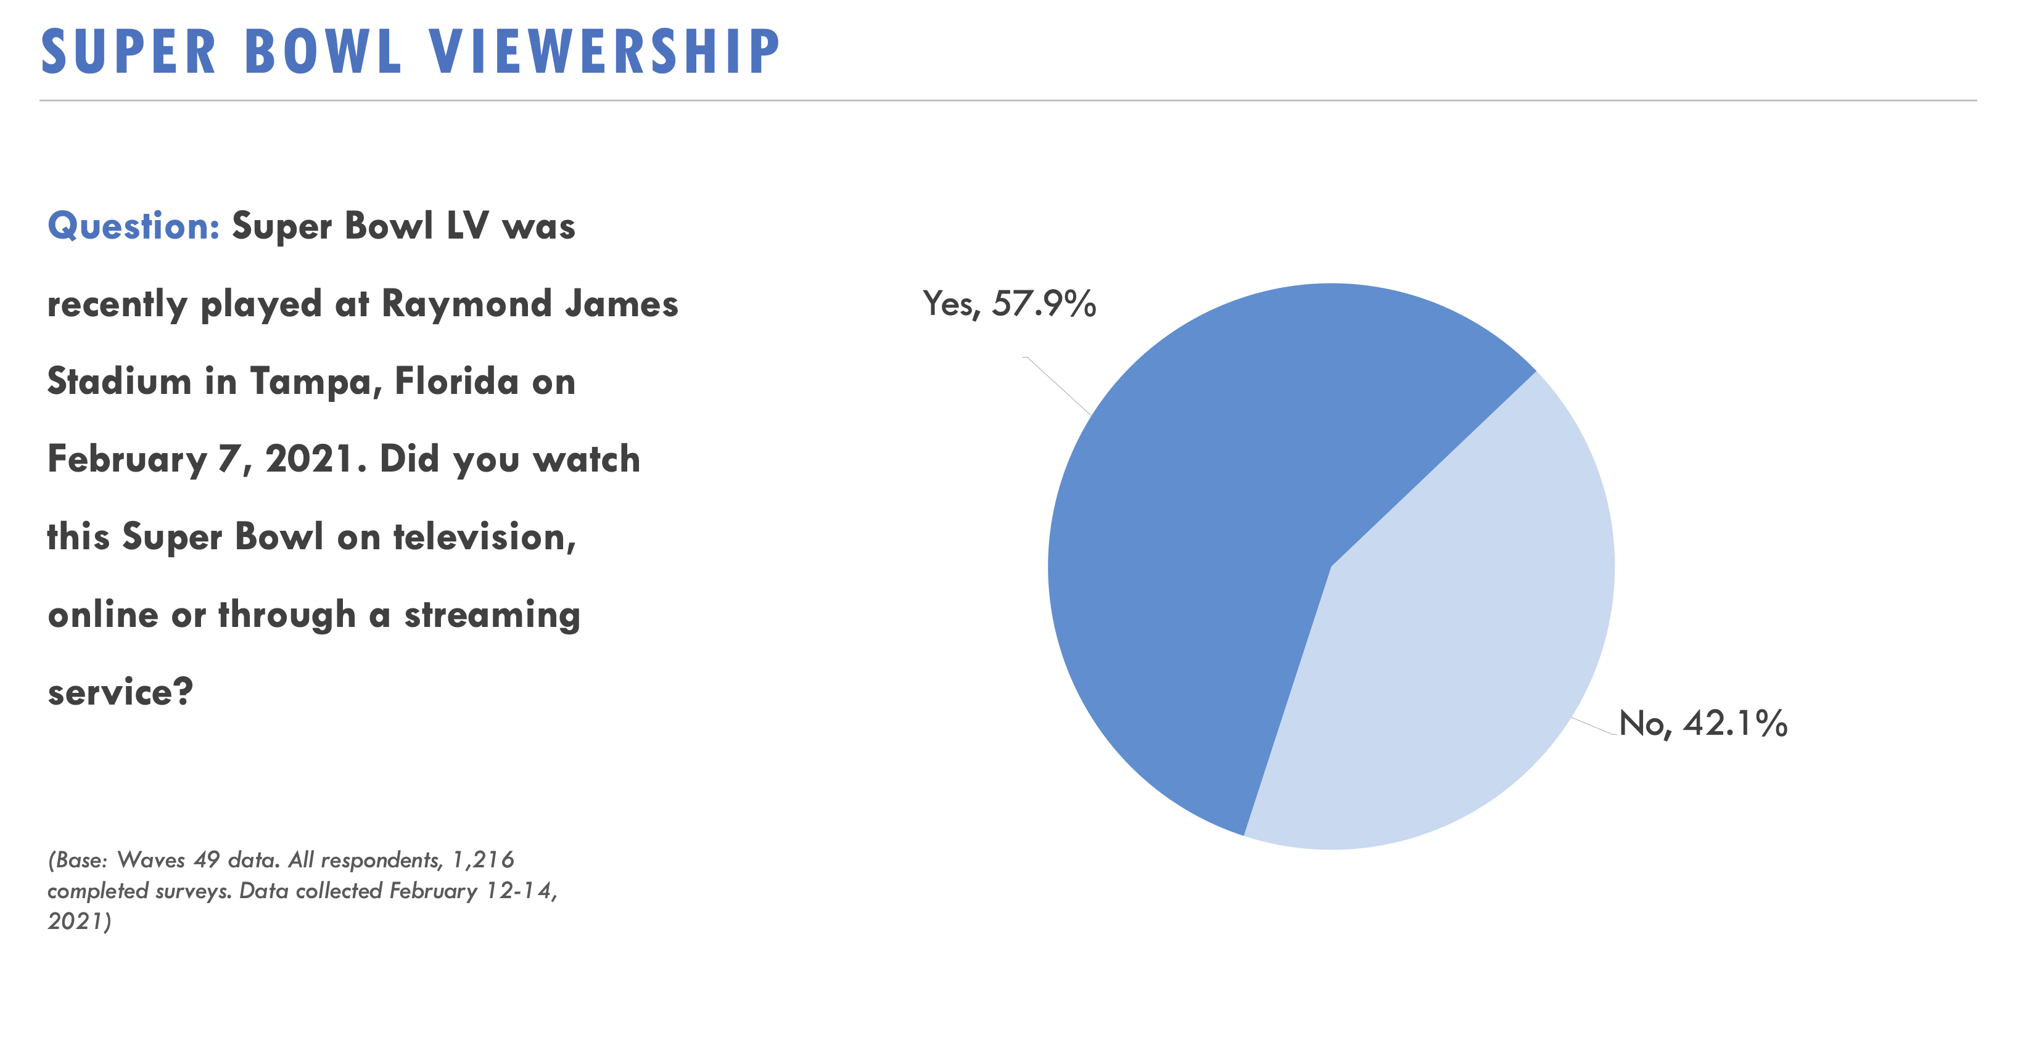

Slide 16
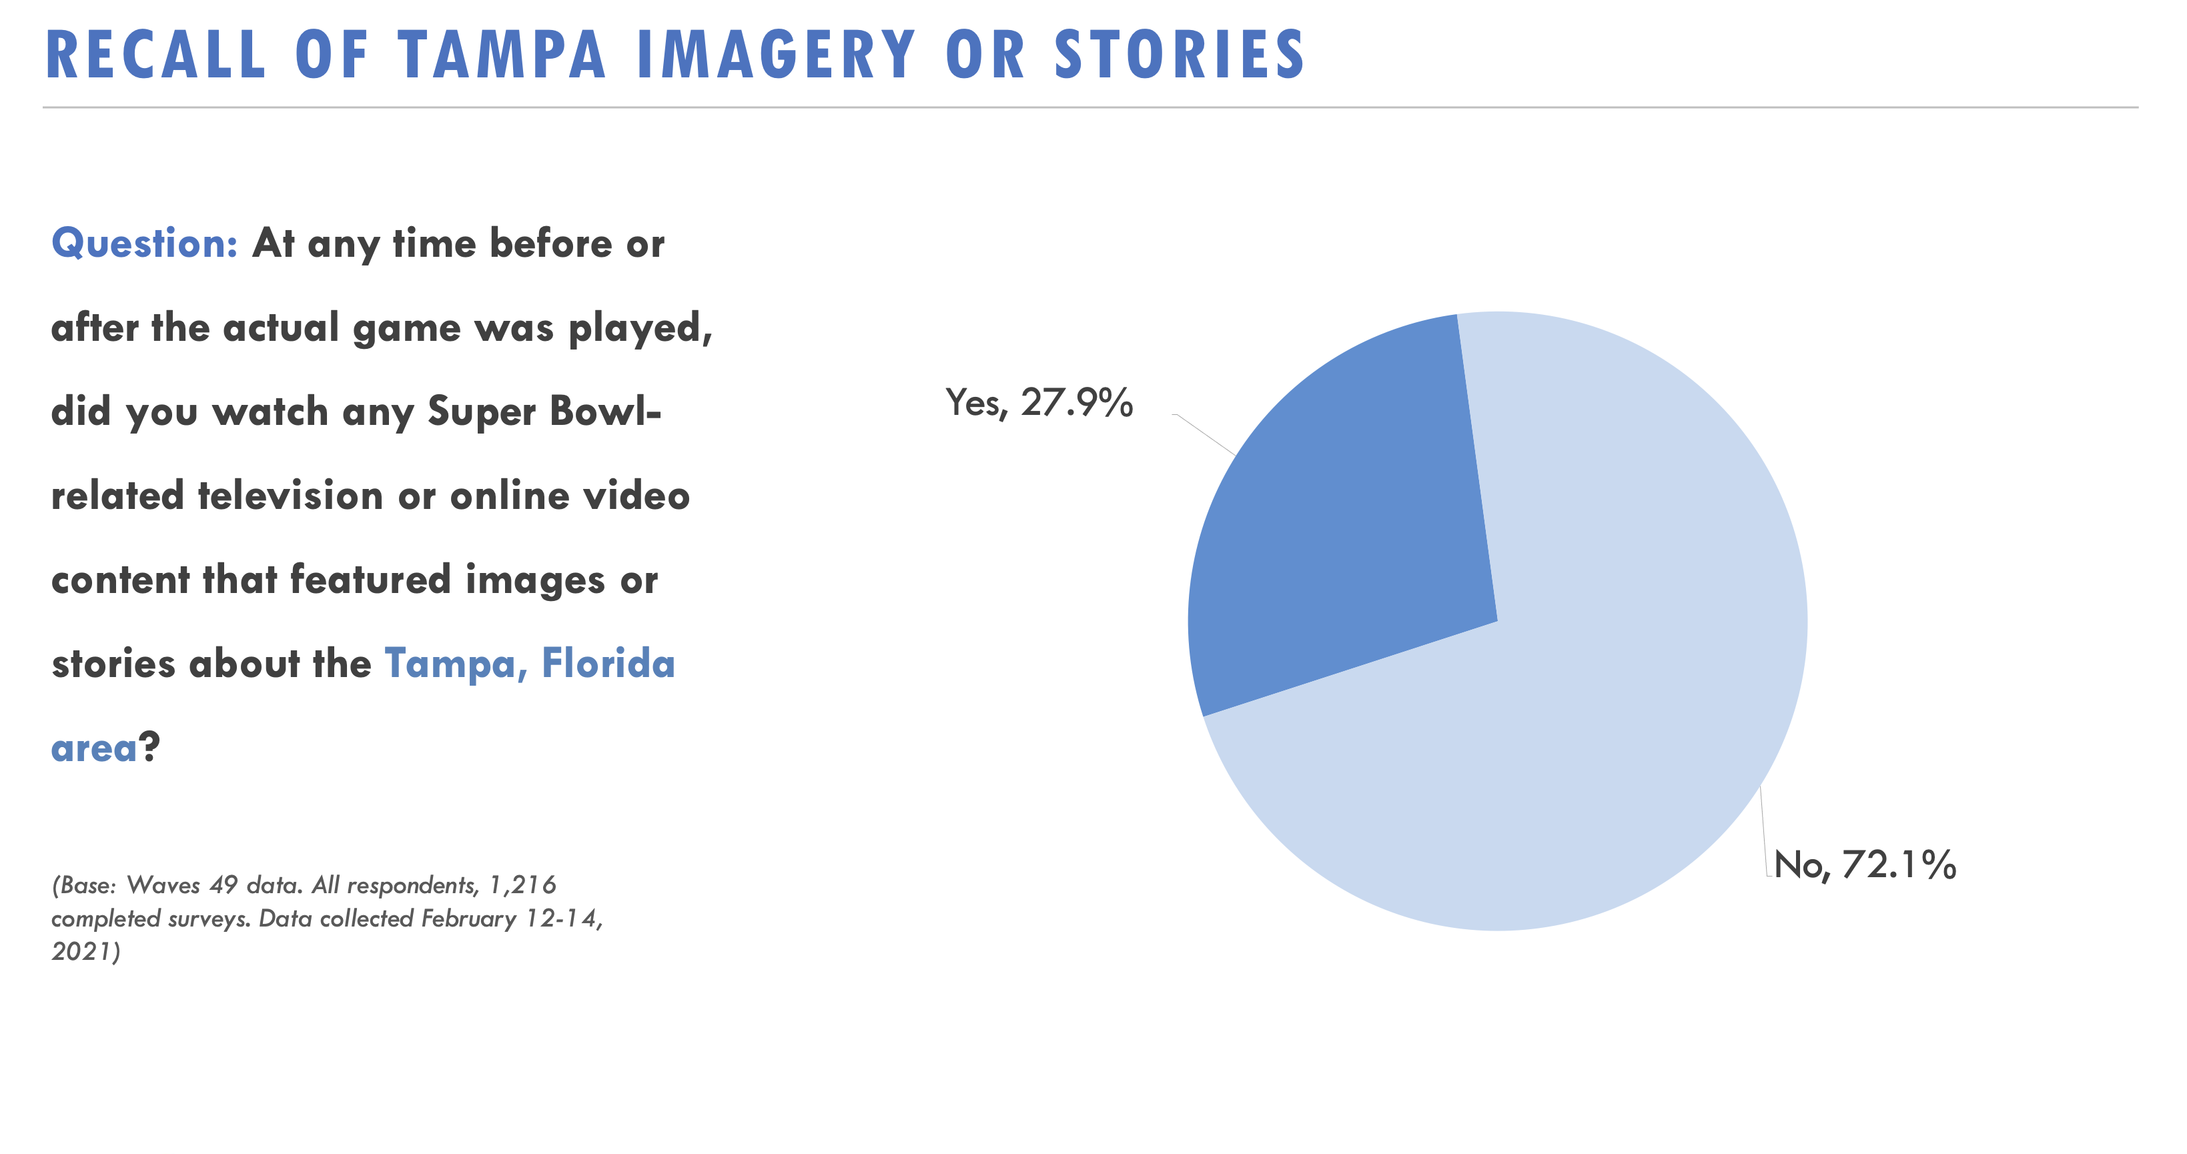

Slide 17
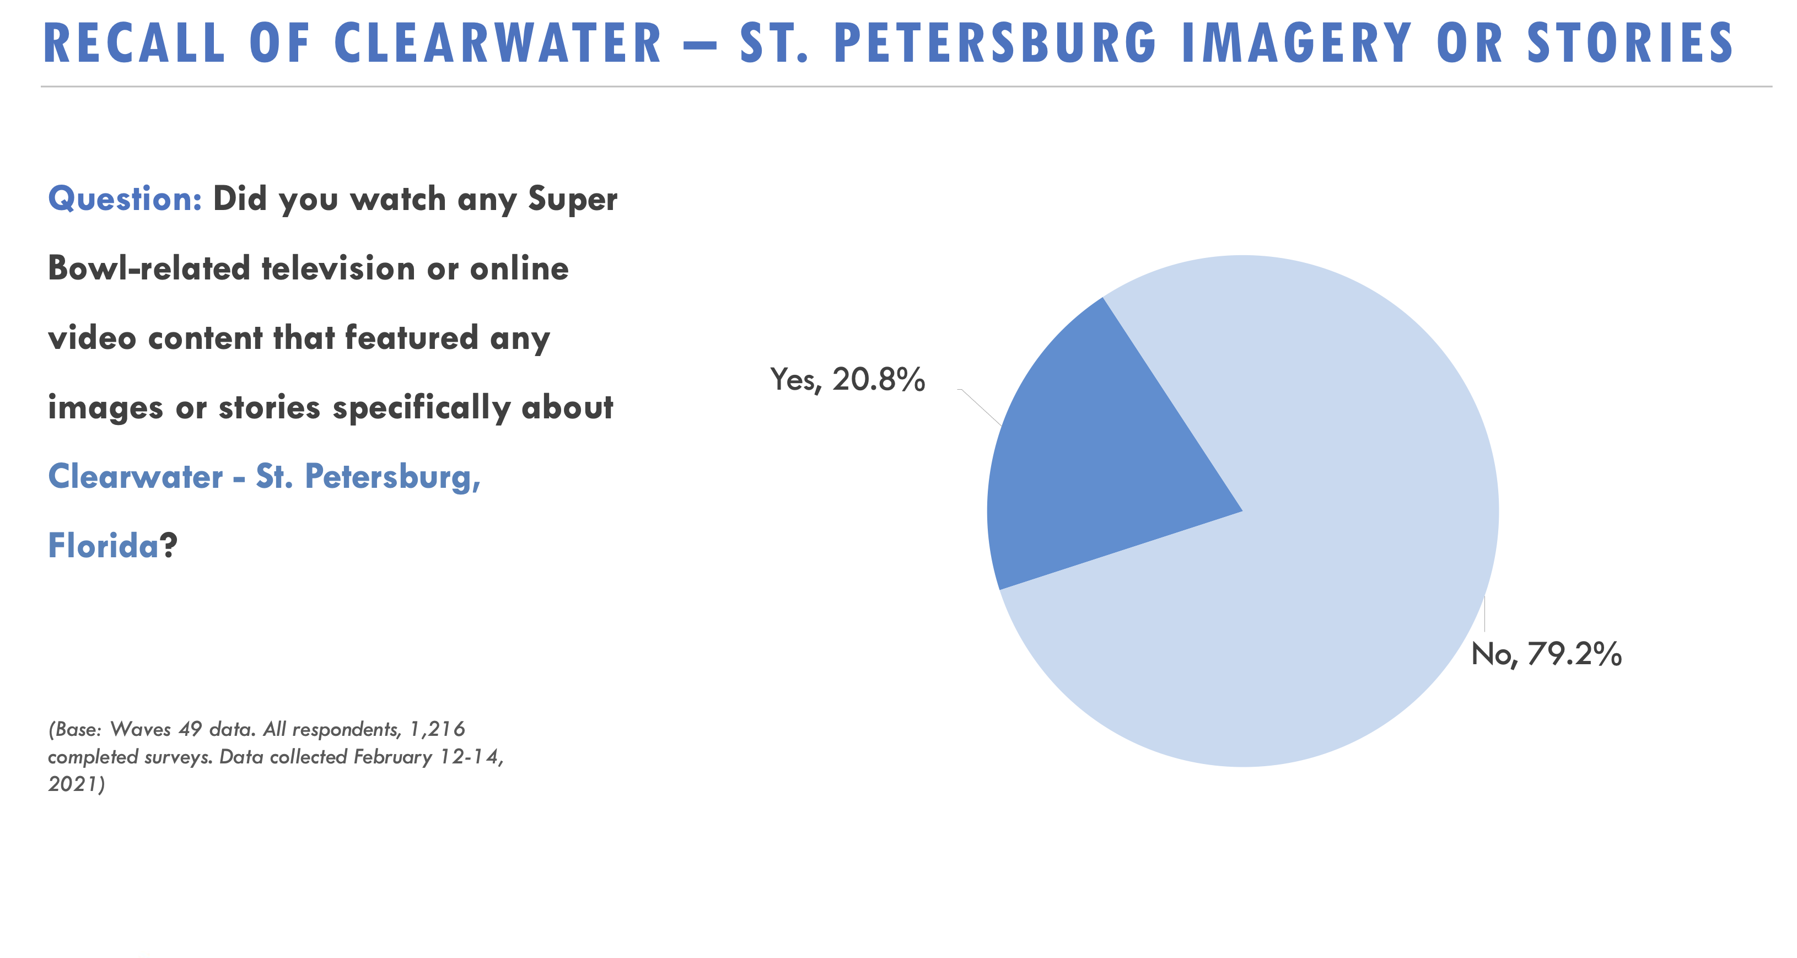

Slide 18
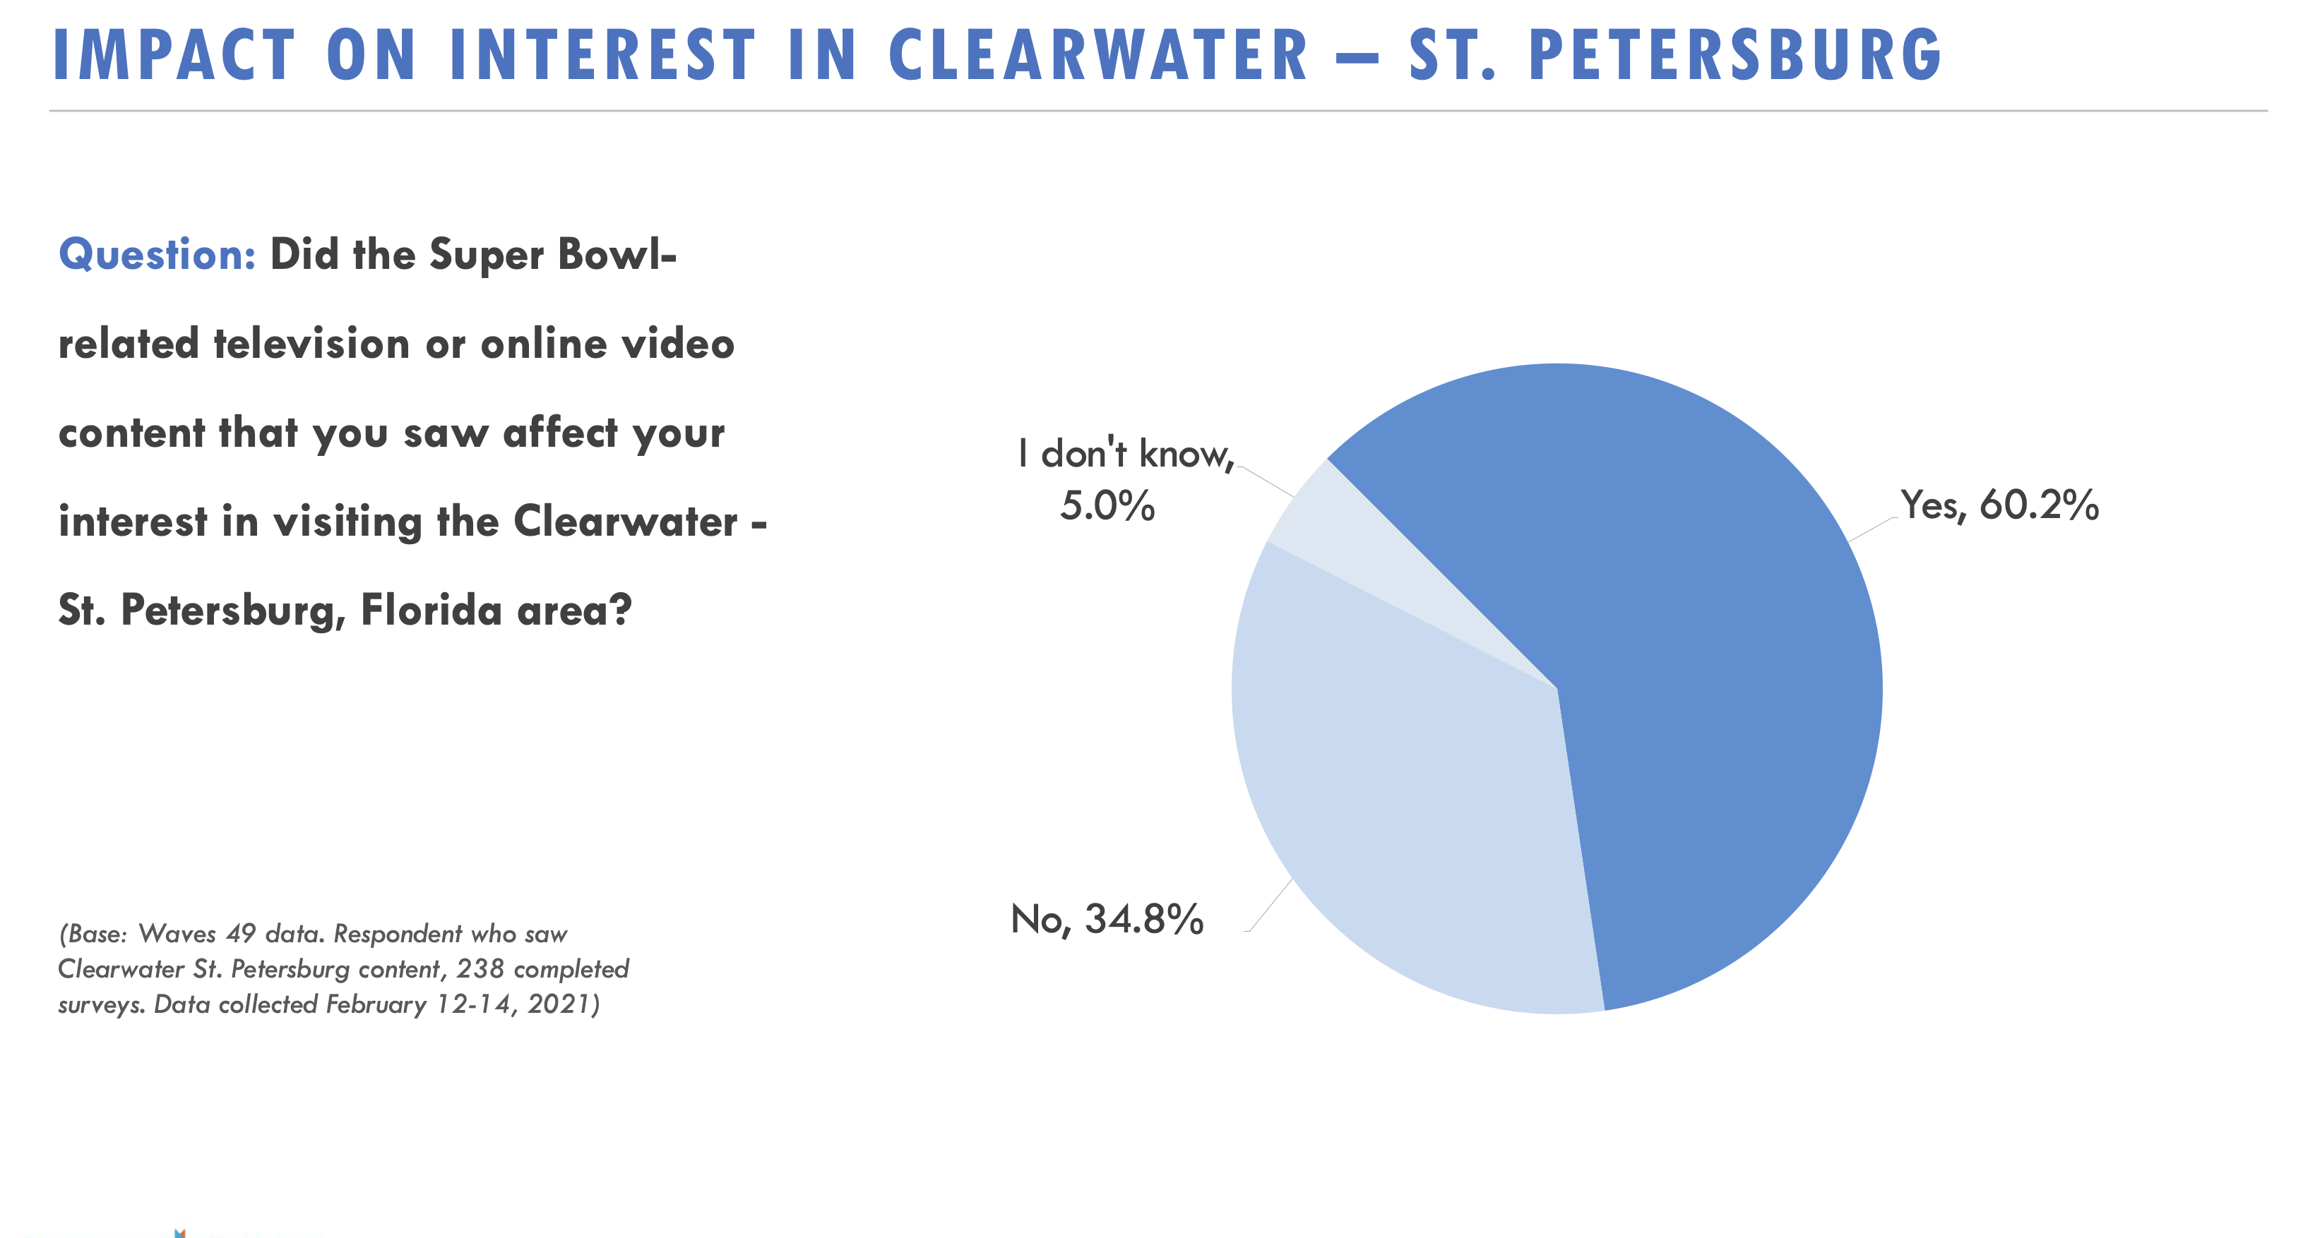

Slide 19
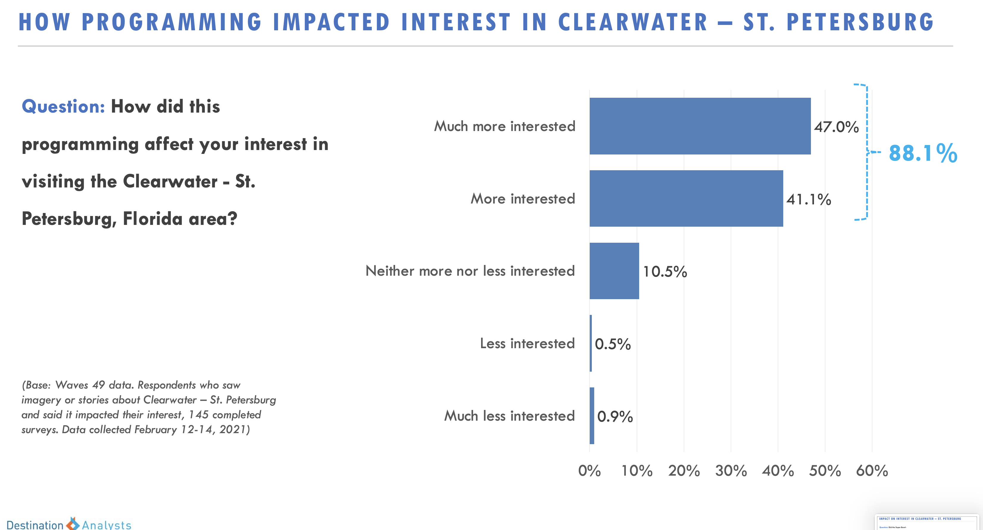

Slide 20
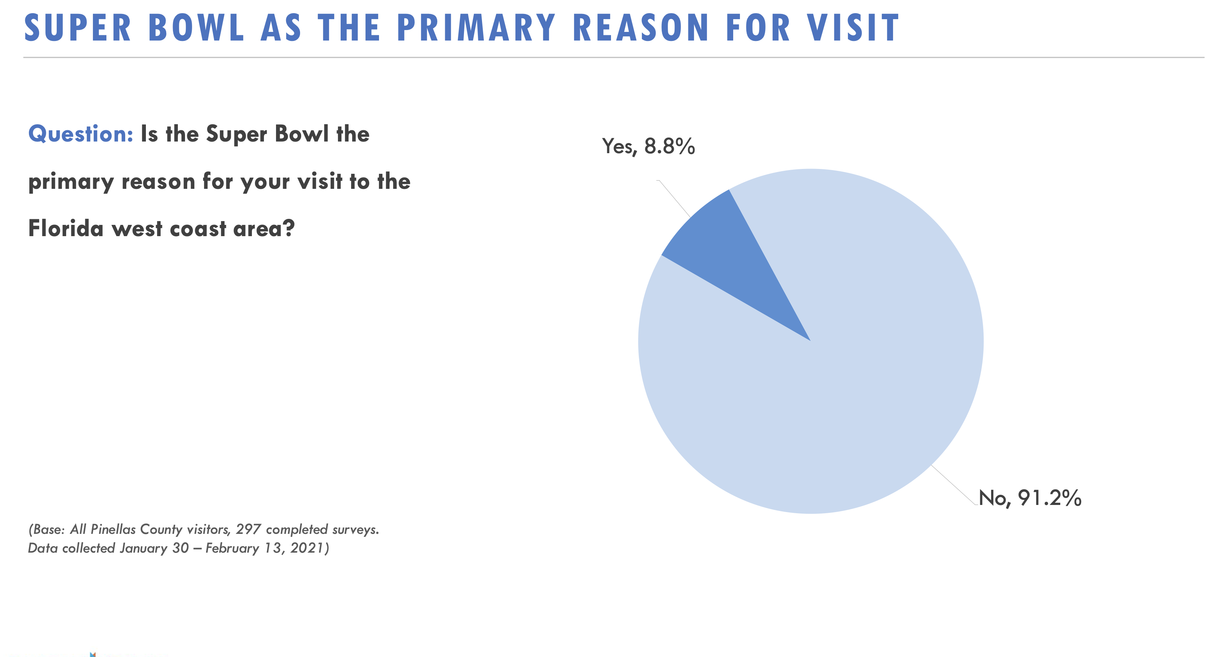

Slide 21
Super Bowl LV | Pinellas County Arrival Analysis
Multi-dimensional Visitation Intelligence

Slide 22
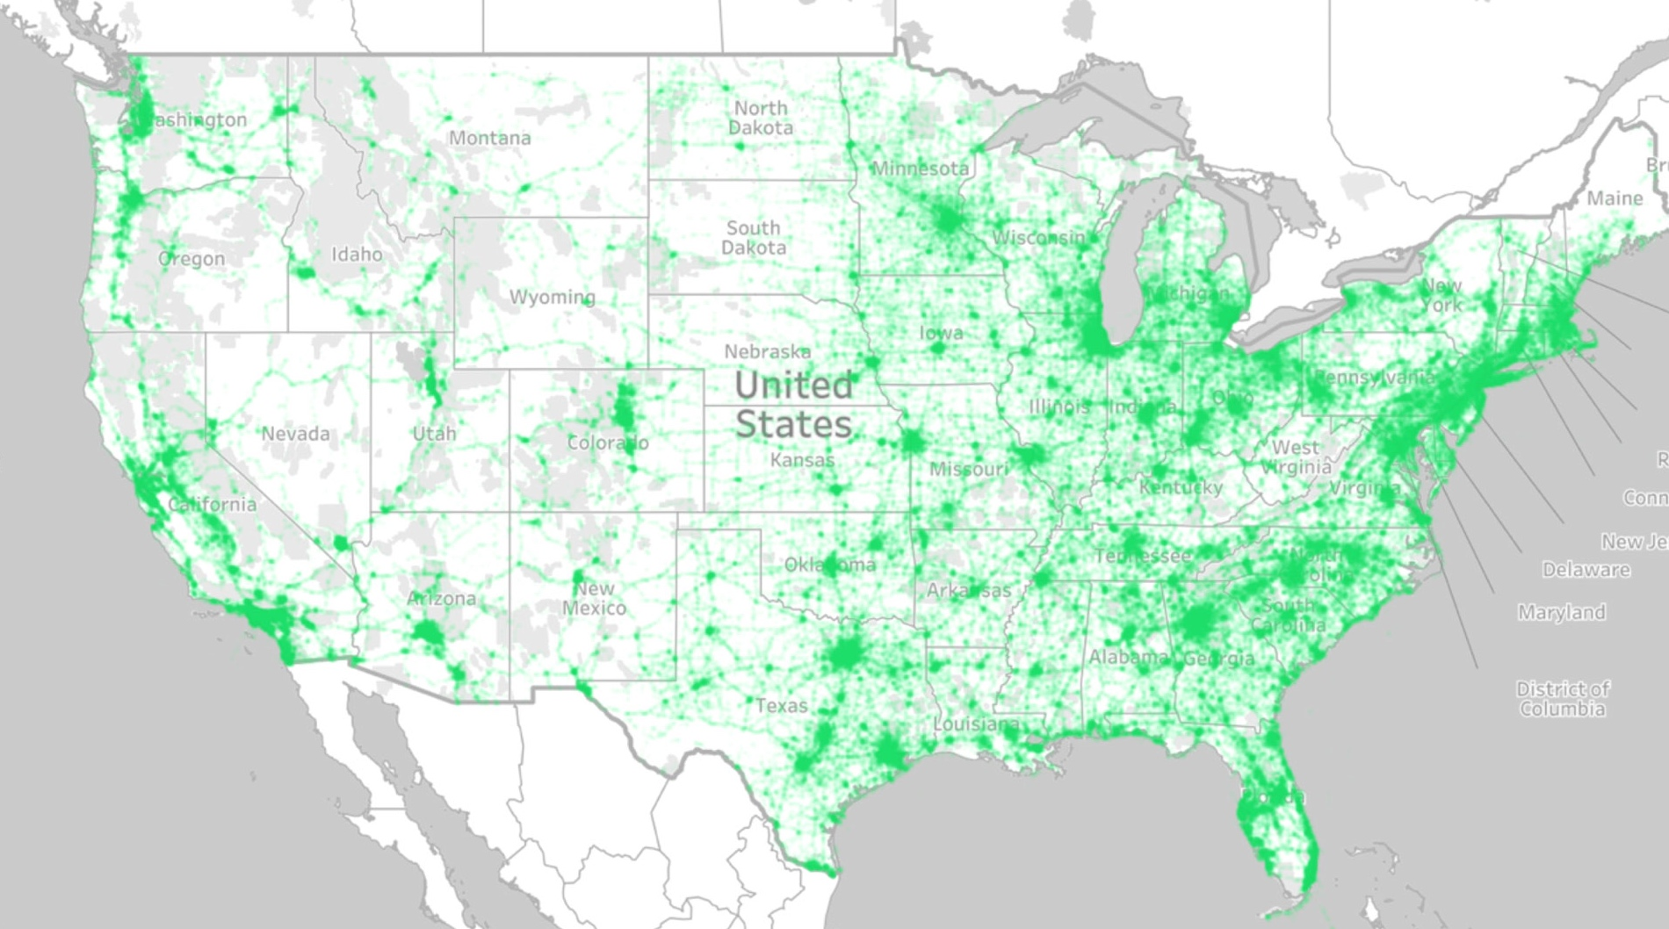

Arrivalist’s Calibrated
Panel Data
Anonymized, multi-sourced GPS location data for millions of users, accurate to 30 feet
Rigorously calibrated to be an accurate representation of the
US population
Privacy Law Compliant
(CCPA & GDPR)
Rigorous Trip Model Criteria

Slide 23









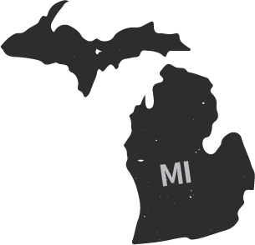






























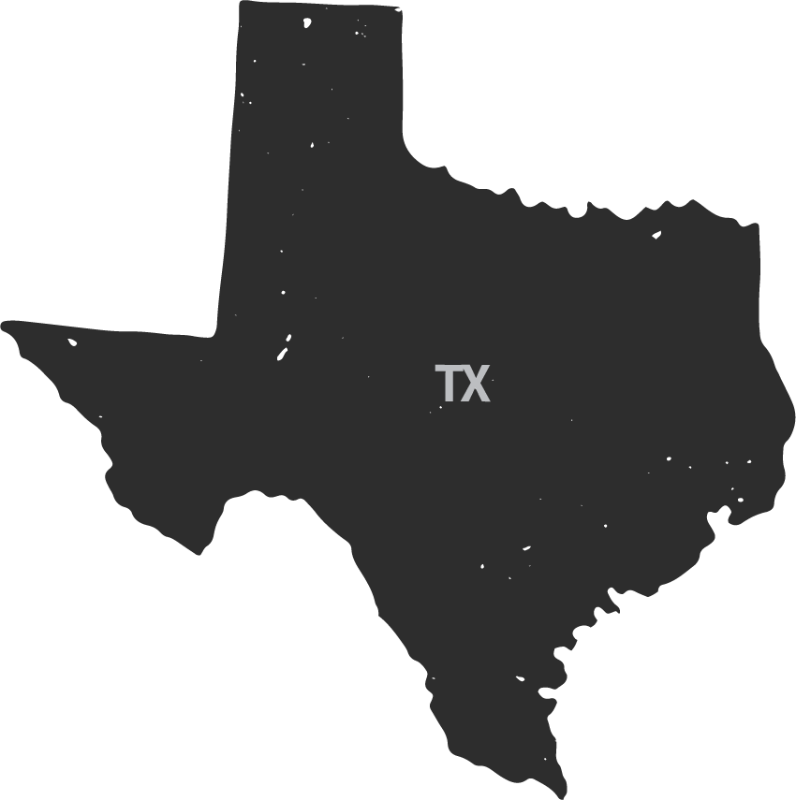







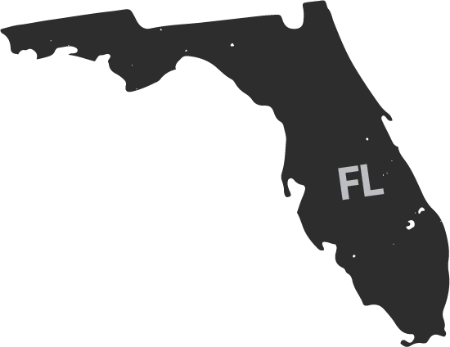

Who “Showed Up”?
Arrivalist Visit Model. Arrival Zone = Pinellas County. Smartphone Data. No mileage min.

Slide 24
Missouri in Top 10
Michigan Shows Up for Tom Brady…Or Do They?
Home State | % of Total Arrivals Feb 4-8 21
Florida | 76.1%
Michigan | 2.1%
Ohio | 1.9%
Illinois | 1.7%
New York | 1.5%
Georgia | 1.4%
Indiana | 1.3%
Pennsylvania | 1.1%
Missouri | 1.3%
Texas | 1.0%
Arrivalist Visit Model. Arrival Zone = Pinellas County. Smartphone Data. No mileage min.
Sample 29,355 Universe trips to MAZ.

Slide 25
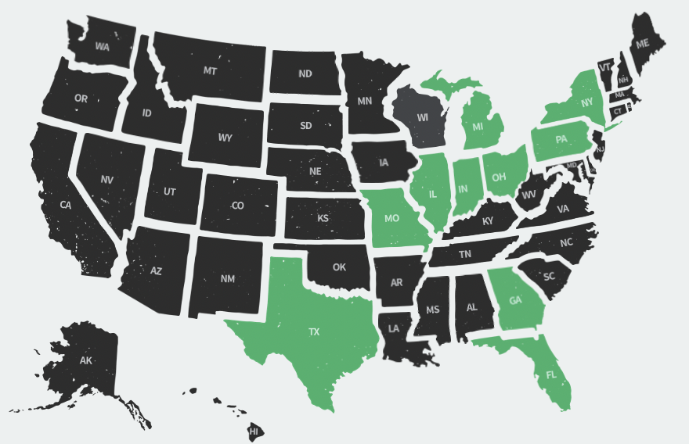
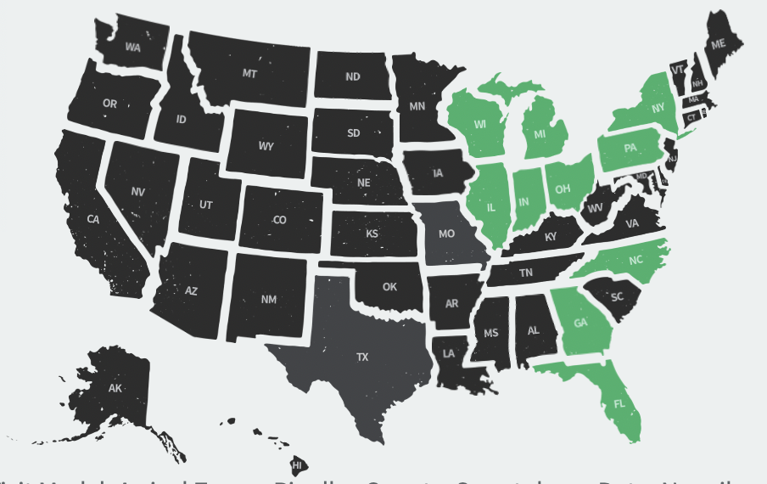
Missouri in Top 10
Michigan Shows Up for Tom Brady…Or Do They?
Home State | % of Total Arrivals Feb 4-8 21
Florida | 76.1%
Michigan | 2.1%
Ohio | 1.9%
Illinois | 1.7%
New York | 1.5%
Georgia | 1.4%
Indiana | 1.3%
Pennsylvania | 1.1%
Missouri | 1.3%
Texas | 1.0%
Home State | % of Total Visitors, Feb 6-10, 2020
Florida | 72.8%
Michigan | 2.4%
New York | 2.3%
Illinois | 1.9%
Ohio | 1.9%
Pennsylvania | 1.3%
North Carolina | 1.3%
Georgia | 1.2%
Indiana | 1.1%
Wisconsin | 1.1%
Arrivalist Visit Model. Arrival Zone = Pinellas County. Smartphone Data. No mileage min.
Left, Universe Trips. Right, Calibrated Panel Trips.

Slide 26
Fly vs. Presumed Drive | Smartphone Arrivals
An estimated 8 in 10 visitor arrivals occurred by car, while 2 in 10 were through St. Pete or Tampa International Airports. Chicago, Detroit, and Kansas City were the top origin markets for flights in our initial analysis.
Fly trips are defined as qualified trips that involve a POI trips to St Pete/Clearwater International Airport or Tampa International Airport.
Presumed drive trips do not involve one of these airports.
The most accurate read will occur when the Calibrated Panel is updated.
Reflect Feb 2021 trips that concluded as of 2/8/21. Universe panel real trips only. Calibrated Panel data to be published on March 15, 2021. Sample 2,824 total trips.

Slide 27
Fly vs. Presumed Drive | Smartphone Arrivals
The share of drive trips is up significantly due to the pandemic and the resurgence of road trips.
Feb 4-8, 2021 v Feb 6-10, 2020. Primary trips to Pinellas Co.

Slide 28
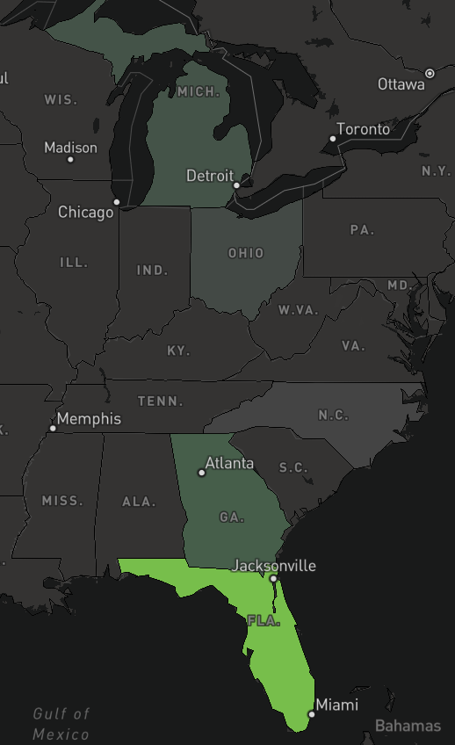
Origin Markets | Road Trip Arrivals | States
Florida residents were responsible for 7 in 10 road trip arrivals to Pinellas County from Feb 4 – 10, 2021. Michigan, #3, for vehicle arrivals, had the longest length of stay (3.0 unique days) as of the reporting date amongst top origin states.
Origin State | Share of All Trips | Overnight % | Average of Length of Stay (Unique Days)
FL | 71.7% | 63.4% | 1.3
GA | 5.4% | 81.9% | 2.0
MI | 3.0% | 89.8% | 3.0
NC | 1.7% | 83.5% | 2.7
OH | 1.9% | 75.1% | 2.8
Length of stay reflects trips that concluded as of 2/10/21

Slide 29
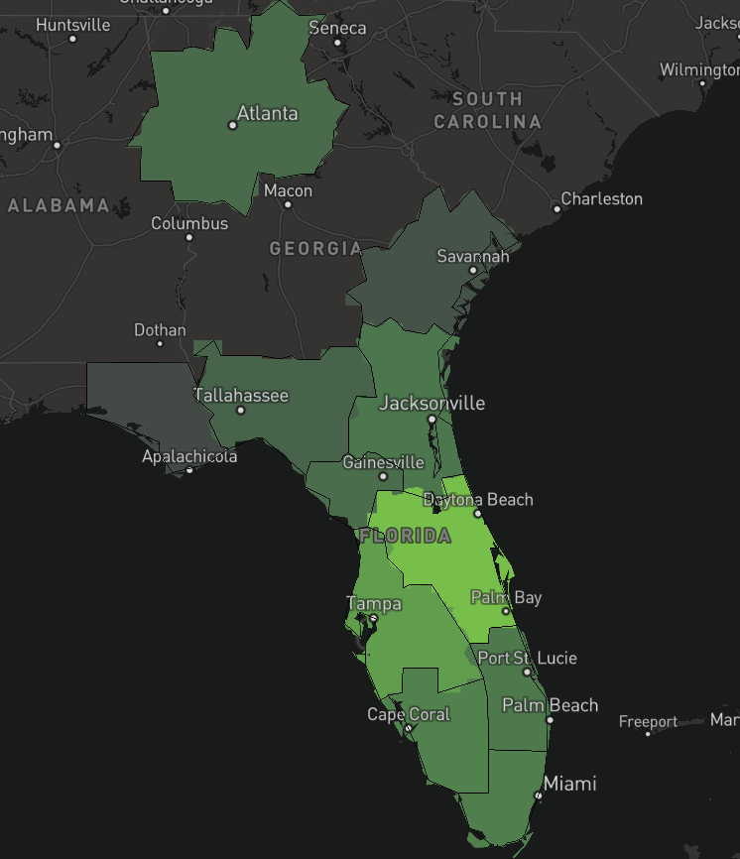
Origin Markets | Road Trip Arrivals | DMAs
Origin DMA | Share of All Trips | Overnight % | Average of Length of Stay (Unique Days)
Orlando/Daytona | 26.7% | 60.9% | 1.3
Tampa/Saint Petersburg (excl. 50 mi) | 15.9% | 36.9% | 0.7
Fort Myers/Naples | 8.7% | 61.1% | 1.3
Miami/Fort Lauderdale | 6.2% | 81.2% | 1.9
Jacksonville-Brunswick | 5.6% | 84.3% | 1.9
West Palm/Fort Pierce | 5.1% | 87.2% | 1.9
Gainesville | 3.1% | 68.5% | 1.8
Atlanta | 2.7% | 83.2% | 2.3
Tallahassee/Thomasville | 2.6% | 83.2% | 2.1
Chicago | 1.1% | 84.8% | 3.5
Length of stay reflects trips that concluded as of 2/10/21

Slide 30
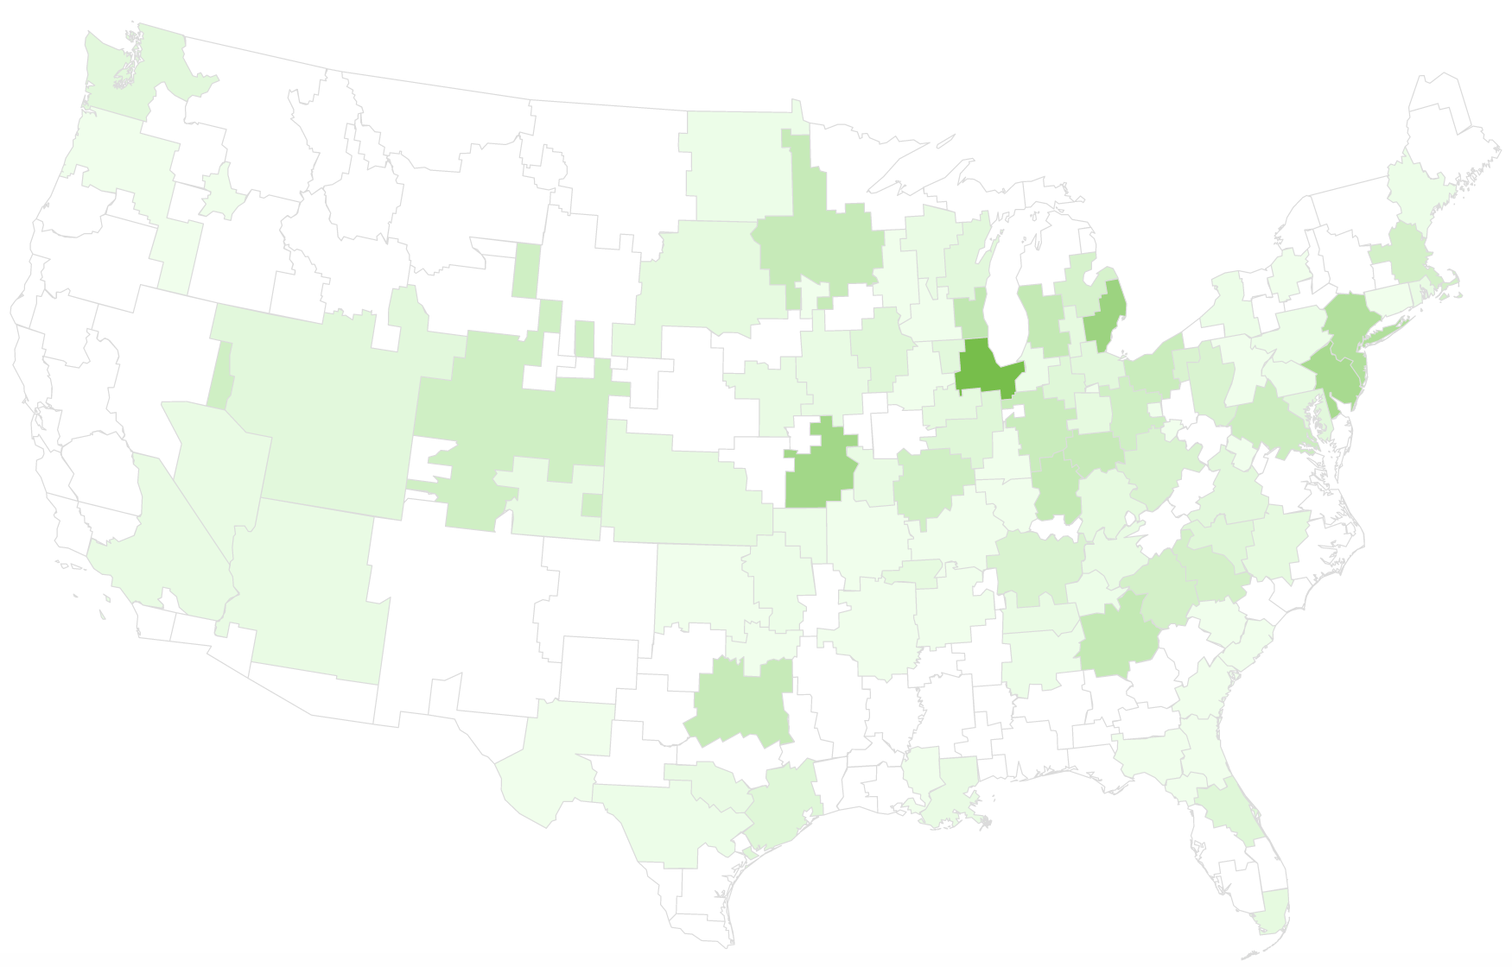
Origin Markets | Smartphone Arrivals | Airports
Origin DMA | Share of Fly Trips
Chicago | 7.0%
Detroit | 4.8%
Kansas City | 4.5%
Philadelphia | 4.1%
New York | 3.6%
Reflect Feb 21 trips that concluded as of 2/9/21. Universe panel real trips only. Calibrated Panel data to be published on March 15, 2021. Total sample size 584 airport arrivals. Markets with 20+ shown.

Slide 31
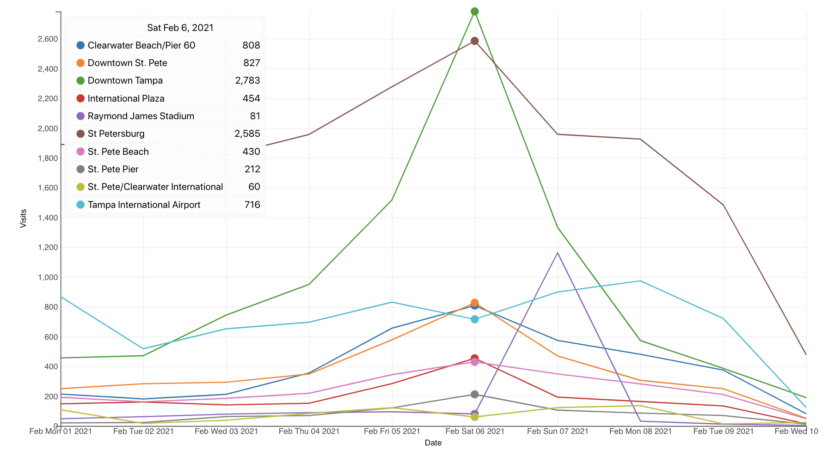
Super Bowl| Smartphone Arrivals | Select POIs
Universe panel real trips only. Calibrated Panel data to be published on March 15, 2021.
Notes:
St Pete and Downtown Tampa see visits peak on Saturday the 6th.

Slide 32
Executive Summary | Super Bowl Effect | Pinellas County
Arrivalist’s combination of automotive and smartphone panels allowed for an initial analysis within one week of the event.
Saturday, Feb 6, was the top vehicular arrival day of 2021 leading up to President’s Day weekend.
Trips in the 100-250 mile distance band from home represented the greatest share of trips during the Super Bowl weekend.
Florida residents were responsible for 7 in 10 road trip arrivals to Pinellas County from Feb 4 – 8, 2021. Michigan, #3, for vehicle arrivals, had the longest length of stay (3.0 unique days).
An estimated 8 in 10 visitor arrivals occurred by car, while 2 in 10 were through St. Pete or Tampa International Airports. Chicago, Detroit, and Kansas City were the top origin markets for flights.
Nearly 1 in 4 visitors to Raymond James Stadium also made a visit to Pinellas County, while only About 1% of Pinellas Co visitors went to Raymond James Stadium during the study dates.
Of select POIs, both St. Pete Beach and Raymond James Stadium were visited primarily by non-locals (residing 50+ miles from each POI, respectively).
Notes:
Arrivalist was invited by Visit St. Pete Clearwater to provide a multi-dimensional visitation intelligence analysis around visitor behavior during Super Bowl LV.

Slide 33
Tdc meeting
2.17.21
preliminary super bowl lv recap

