Slide 1
Pinellas county tourist development council meeting
March 29, 2023
9:00 a.m. – 12:00 p.m.

Slide 2
Tourist Development Tax - Monthly
Metric 2023 FY 23 2022 FY 22
January Collections $8.2M $27M $7.4M $25M

Slide 3
TDT Collections by Municipality
CITY | Jan. 2023 | Jan. 2022 | Change
Belleair/Belleair Beach | $24,915.78 | $21,455.92 | 16.1%
Clearwater/Clearwater Beach | $1,707,000.29 | $1,583,007.80 | 7.8%
Dunedin | $94,018.91 | $83,089.15 | 13.2%
Indian Rocks Beach | $70,794.65 | $67,059.42 | 5.6%
Indian Shores | $40,823.39 | $37,173.47 | 9.8%
Madeira Beach | $124,121.69 | $115,092.77 | 7.8%
Miscellaneous/Other | $3,729,879.06 | $3,427,311.27 | 8.8%
N Redington Beach/Redington Shores | $106,043.18 | $102,965.73 | 3.0%
Oldsmar/Safety Harbor | $145,263.96 | $87,768.06 | 65.5%
Palm Harbor | $113,888.73 | $103,083.43 | 10.5%
St Pete Beach/Tierra Verde | $873,610.23 | $733,517.31 | 19.1%
St Petersburg | $884,817.11 | $691,078.62 | 28.0%
Tarpon Springs | $41,587.90 | $38,698.02 | 7.5%
Treasure Island | $282,731.16 | $244,867.21 | 15.5%

Slide 4
Destination Metrics - Lodging
Metric (Feb) 2023 2022
Occupancy (Hotel) 83% 79%
Occupancy (VR) 90% 90%
Avg. Daily Rate (Hotel) $225 $212
Avg. Daily Rate (VR) $261 $253
Area (Hotels) Feb. 2023 Feb. 2022
Beach (Occupancy) 84% 78%
Inland (Occupancy) 82% 78%
Beach (ADR) $294 $305
Inland (ADR) $170 $159

Slide 5
Lodging Metrics - Occupancy

Slide 6
Lodging Metrics - ADR

Slide 7
DESTINATION METRICS - VR
KPI (February) | 2023 | 2022 | Difference
ADR | $261 | $253 | 3%
Adjusted Paid & Owner Occupancy | 90.5% | 90.4% | 0%
Adjusted RevPAR | $232 | $225 | 3%
Avg. Length of Stay | 10.1 | 9.8 | 3%

Slide 8
DESTINATION METRICS - VR
KPI (Mar.-May) | 2023 | 2022 | Difference
ADR | $282 | $276 | 2%
Adjusted Paid & Owner Occupancy | 65.3% | 68.9% | -5%
Adjusted RevPAR | $170 | $179 | -5%
Avg. Length of Stay | 7.1 | 6.5 | 8%

Slide 9
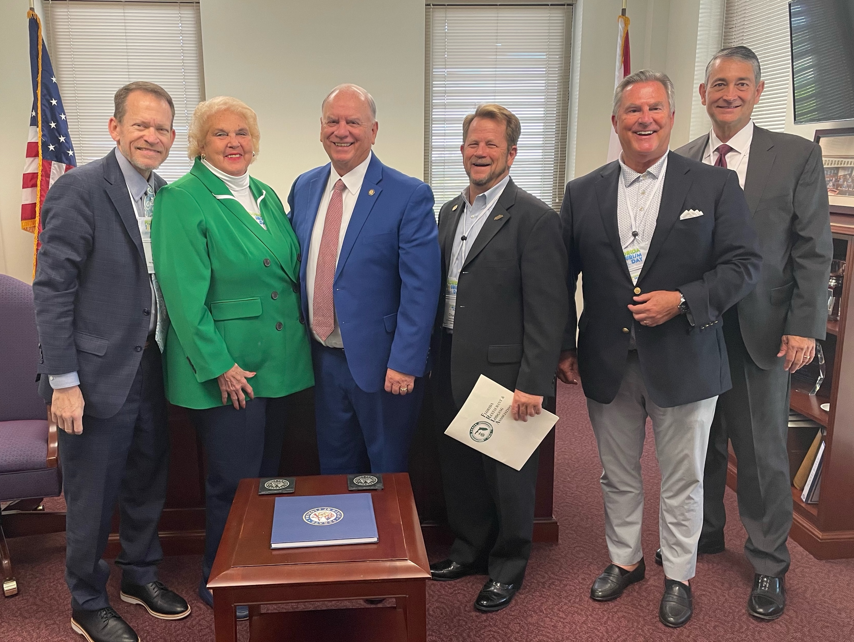
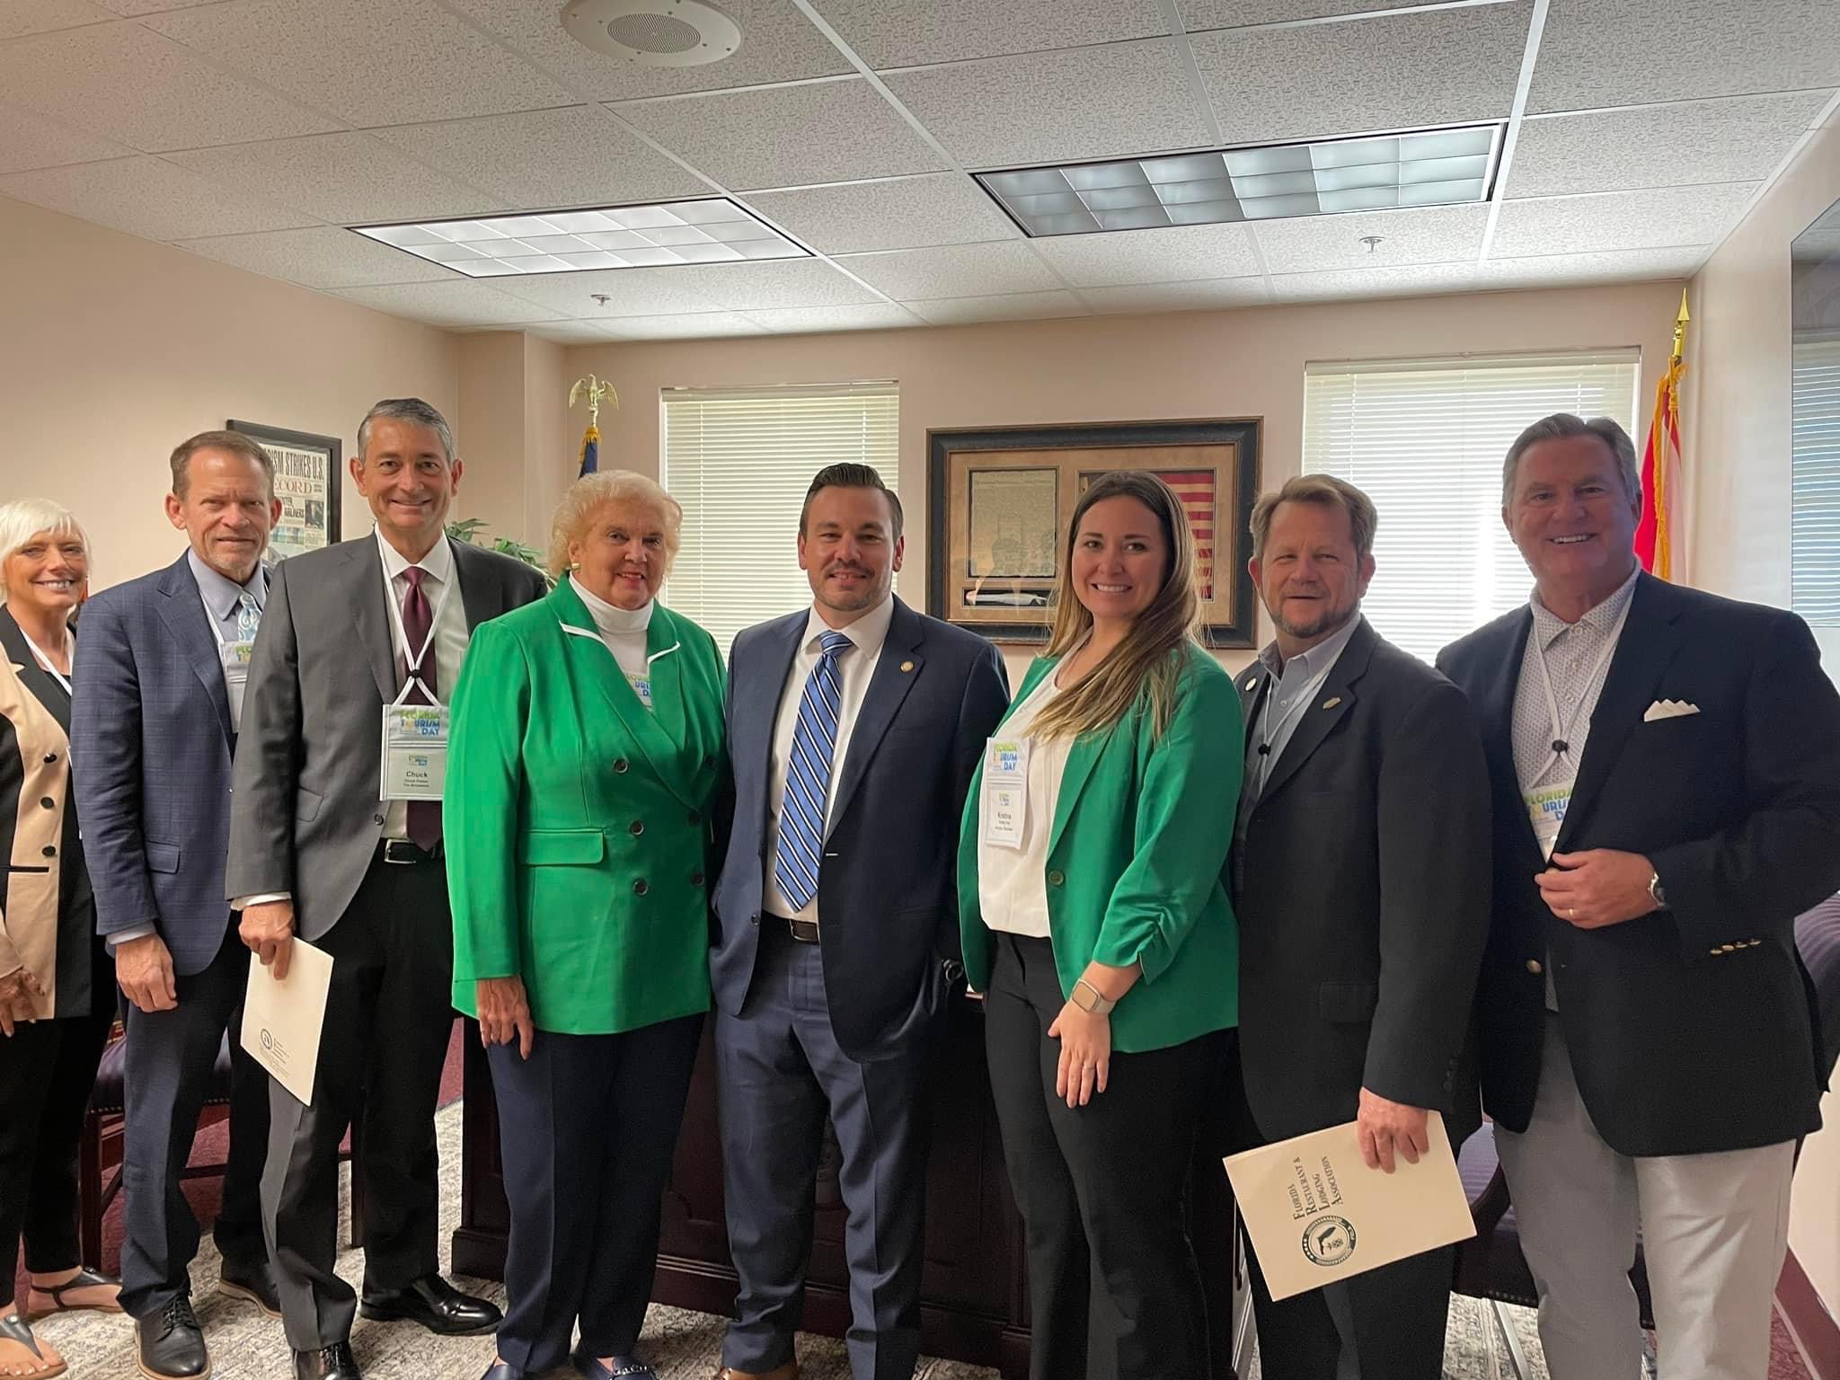
TOURISM DAY 2023

Slide 10
Staffing Update
Open Position | Status | # of Applicants
Brand Manager | Filled | 70
Film Commissioner | Ready to Announce | 36
Community Relations Manager | Final Interviews | 68
Market Intelligence Specialist | Interviewing | 34
Warehouse Specialist | Interviewing | 34
Business Assistant | Interviewing | 22
Director of Communications/PR | Closes Friday | 52
Content & Communications Coordinator | Opens Friday/Advertise 2 weeks
Film Manager | Opens Next Week/Advertise for 2 weeks
Creative Producer | In Development/Advertise in 1 week

Slide 11
Pinellas county tourist development council meeting
NEXT MEETING
April 19, 2023
9:00 a.m. – 12:00 p.m.

