Slide 1
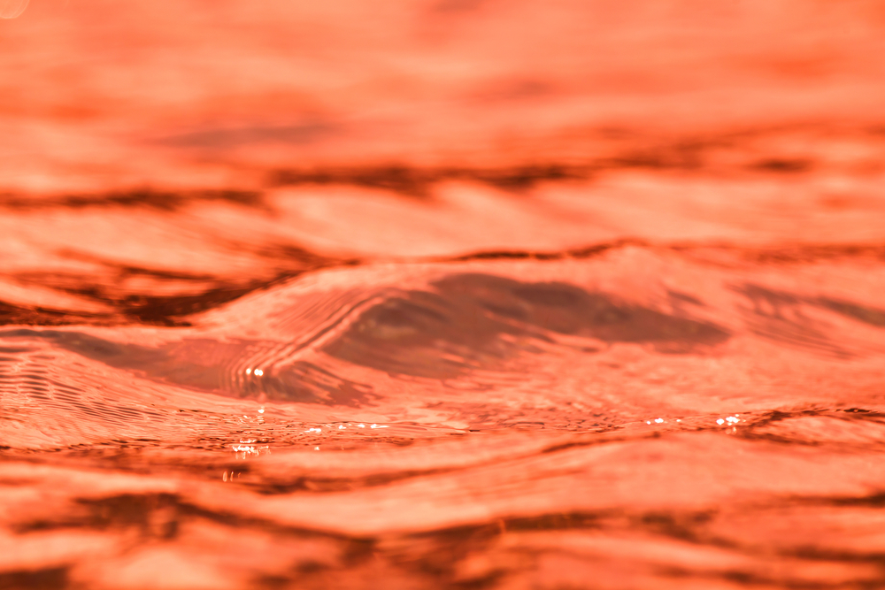
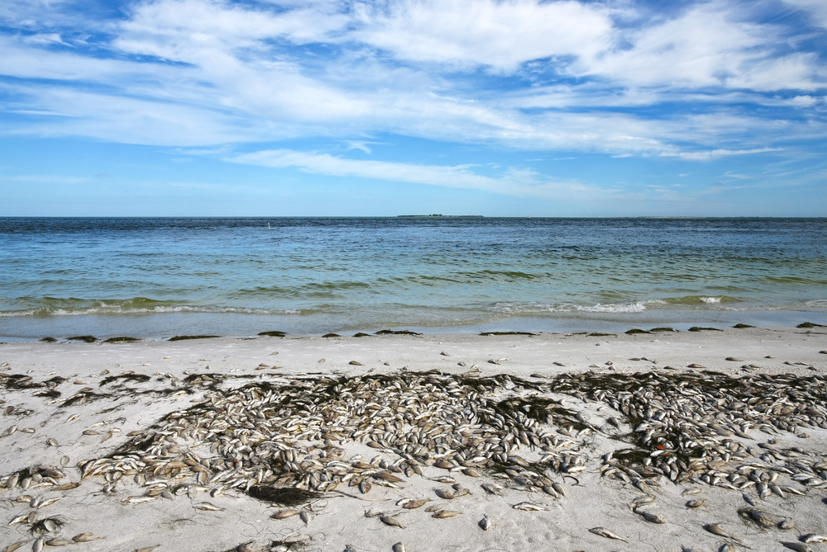
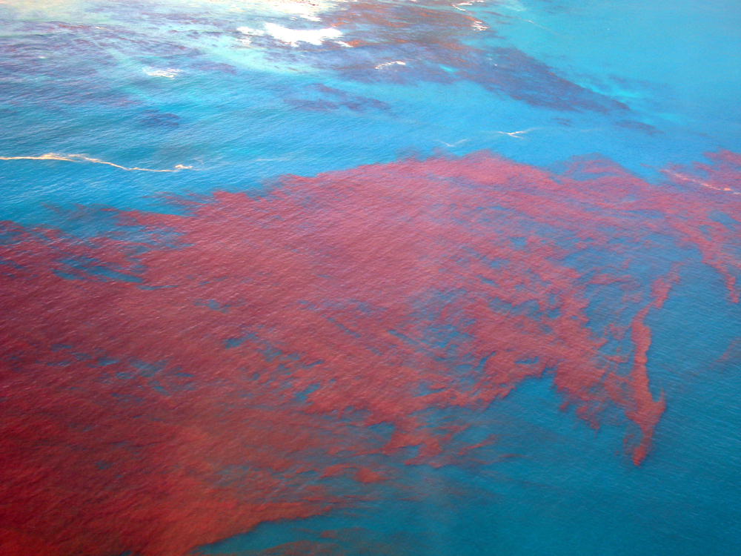

Red tide: Special Question Set
The State of the American Traveler, October 2018

Slide 2
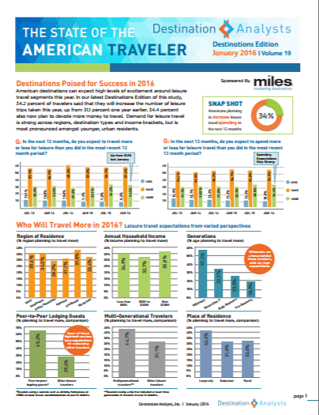
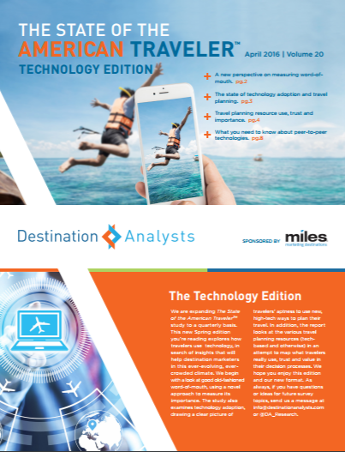

The State of the American Traveler
Online survey conducted October, 2018
Survey invitation sent to a nationally representative sample of US adults
Total sample of 2,030 American leisure travelers
Examines traveler sentiment, motivations & behaviors

Slide 3

Executive Summary (cont.)
Likelihood of Visiting Florida Gulf Coast
Question: In the next TWELVE (12) MONTHS, how likely are you to visit a BEACH DESTINATION on the Florida Gulf Coast?
All Respondents: Base = 2,030 completes
Source: The State of the American Traveler, Destination Analysts, Inc.
Notes:
x

Slide 4
Executive Summary (cont.)
Likelihood of Visiting Florida Gulf Coast
Question: In the next TWELVE (12) MONTHS, how likely are you to visit a BEACH DESTINATION on the Florida Gulf Coast?
Likelihood by Red Tide Awareness Status
Likelihood by Region of Residence
Source: The State of the American Traveler, Destination Analysts, Inc.
Notes:
x

Slide 5
Executive Summary (cont.)
Interest in St. Petersburg/Clearwater
Question: In the next TWELVE (12) MONTHS, how interested would you be in visiting St. Petersburg/Clearwater area of the Florida Gulf Coast?
All Respondents: Base = 2,030 completes
Source: The State of the American Traveler, Destination Analysts, Inc.
Notes:
x

Slide 6
Executive Summary (cont.)
Interest in St. Petersburg/Clearwater
Question: In the next TWELVE (12) MONTHS, how interested would you be in visiting St. Petersburg/Clearwater area of the Florida Gulf Coast?
Interest by Red Tide Awareness Status
Interest by Region of Residence
Source: The State of the American Traveler, Destination Analysts, Inc.
Notes:
x

Slide 7
Executive Summary (cont.)
Awareness of Red Tide Situation
Background: The next few questions will be about a situation currently happening in Florida Gulf Coast area. Please read the following background. Red tide is a naturally-occurring microscopic alga that has been documented along Florida’s Gulf Coast since the 1840’s and occurs nearly every year. Red Tide can harm sea life as well as cause respiratory inflammation and unpleasant burning skin reactions in humans. An unusually persistent red tide — the longest in the area since 2006 — currently is happening along the Florida Gulf Coast.
Question: Prior to taking this survey, had you heard of this year’s Red Tide situation?
All Respondents: Base = 2,030 completes
Source: The State of the American Traveler, Destination Analysts, Inc.
Notes:
x

Slide 8
Executive Summary (cont.)
Impact of the Red Tide
Question: How does this year’s Red Tide situation effect your likelihood of visiting the Florida Gulf Coast in the next year? (Select the choice that best fills in the blank)
As a result of the Red Tide I am ______________ to visit the Florida Gulf Coast in the next year.
All Respondents: Base = 2,030 completes
Source: The State of the American Traveler, Destination Analysts, Inc.
Notes:
x

Slide 9
Executive Summary (cont.)
Impact of the Red Tide
Question: As a result of the Red Tide I am ______________ to visit the Florida Gulf Coast in the next year?
Effect on Likelihood to Visit Gulf Coast by Awareness Status
Effect on Likelihood to Visit Gulf Coast by Region of Residence
Source: The State of the American Traveler, Destination Analysts, Inc.
Notes:
x

