Slide 1
Canada
United Kingdom
Central Europe
Update
Rosemarie Payne – Visit St. Pete/Clearwater
Jayne Brooke – Rooster
Axel Kaus – Kaus Media

Slide 2
Canada Update

Slide 3
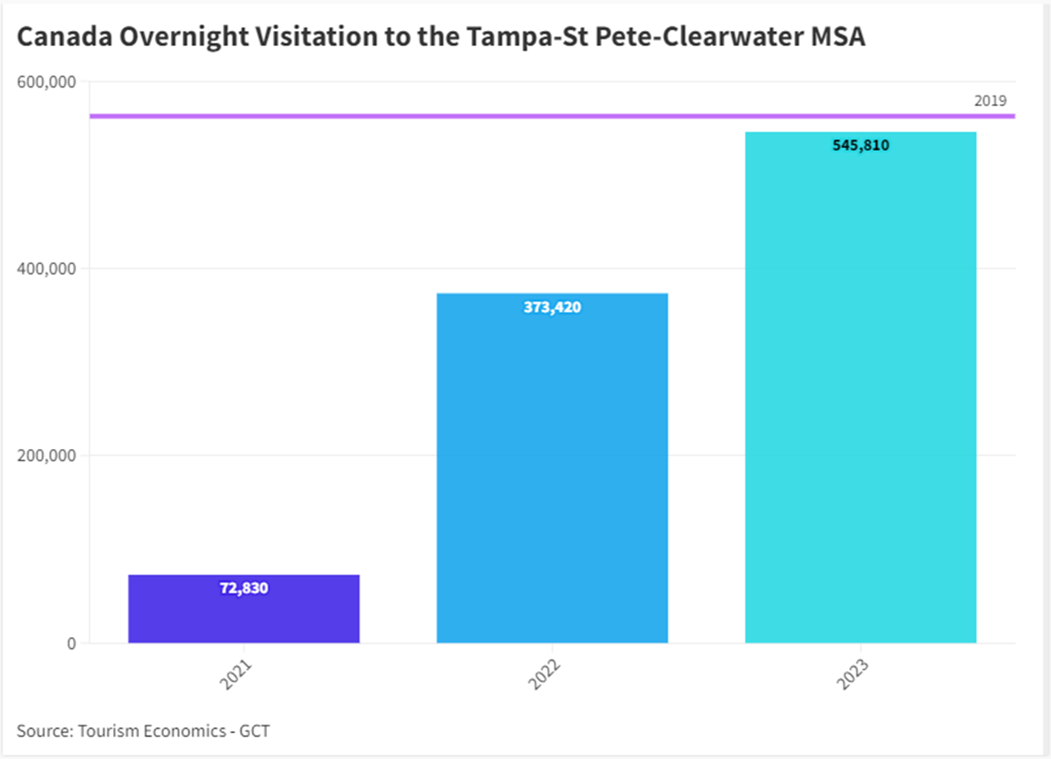

Slide 4
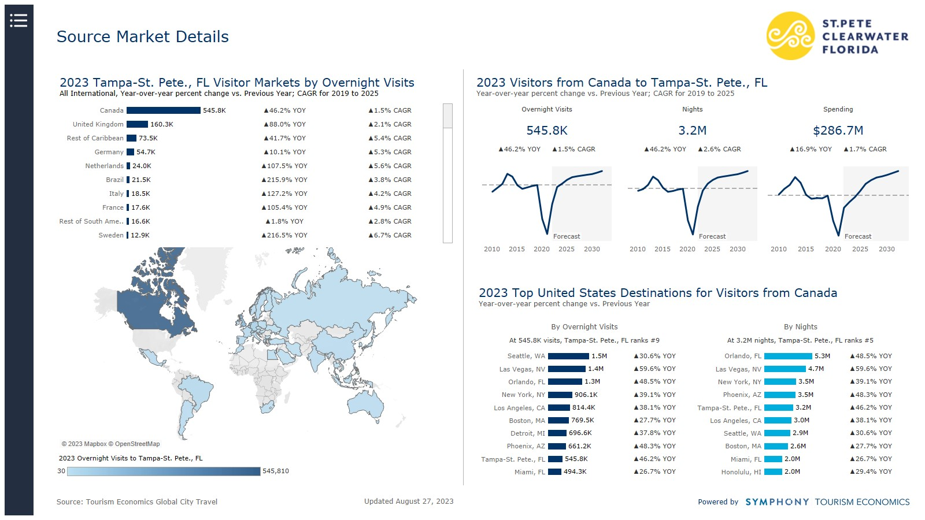

Slide 5
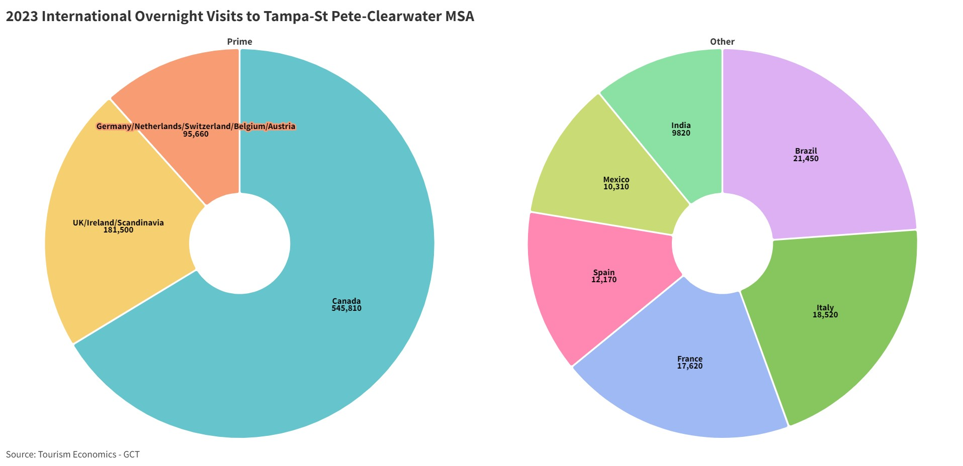

Slide 7
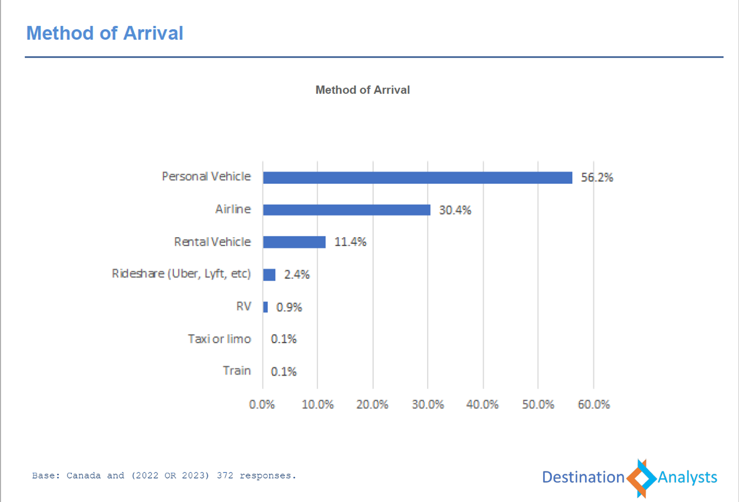

Slide 8
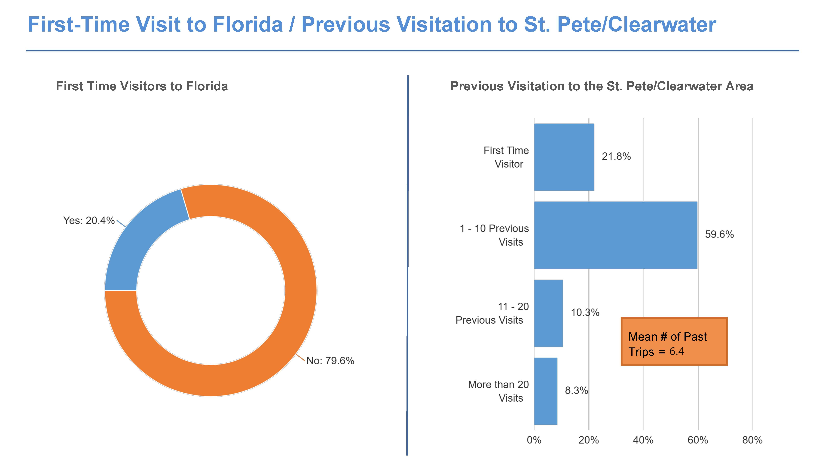

Slide 9
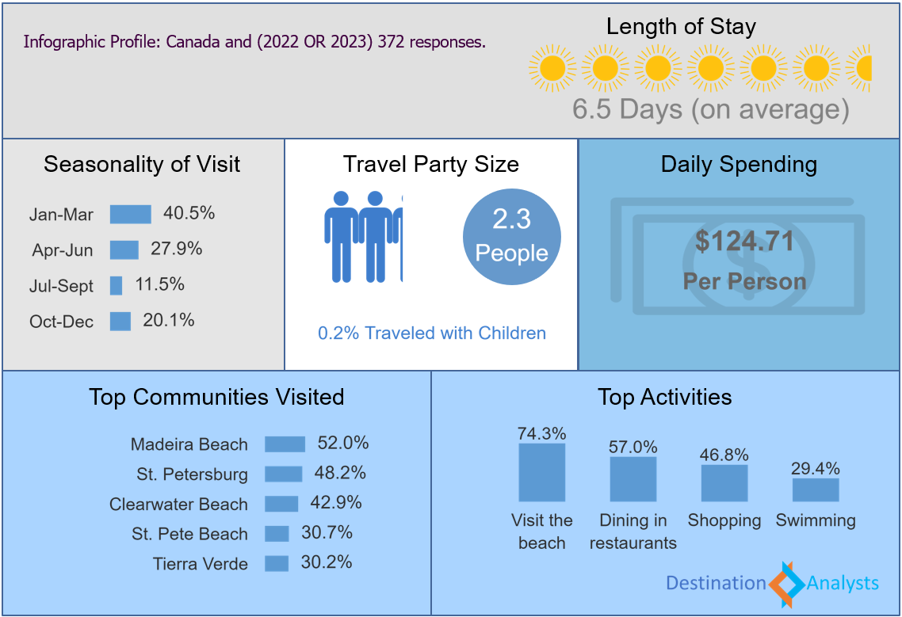

Slide 10
FY23 Key Accomplishments
Canadian Sales Mission – Calgary, Toronto & Montreal
BranchUP – Facebook Initiative
Florida Huddle & IPW Canadian Meetings
Product Launches with Air Canada Vacations & TravelBrands
Canadian Automobile Association/Alberta Motor Association FAM
Hotelbeds Receptive Operator Campaign in Canada

Slide 11
Opportunities & Headwinds
Opportunities
Nonstop Air Service to TPA
  Air Canada – Toronto & Ottawa
  WestJet – Toronto & Calgary (Dec.)
  Lynx Air – Toronto & Montreal (Nov.)
  Porter Air – Toronto
Headwinds
Increased competition from other FL Destinations, Cruises, Caribbean
Political Climate
Canadian Economic Challenges
Weather/Environmental Issues

Slide 12
Looking Ahead to FY24
Visit Florida Training Portal
Brand USA Initiatives (new BUSA Representation in Canada – Casey Canevari)
IPW Canadian Reception
Florida Huddle – Miami
Increased FAM Visits
Tour Operator Product Launches
2 Canadian Sales Missions for April & June 2024

Slide 13
UK/Ireland
Scandinavia Update

Slide 14
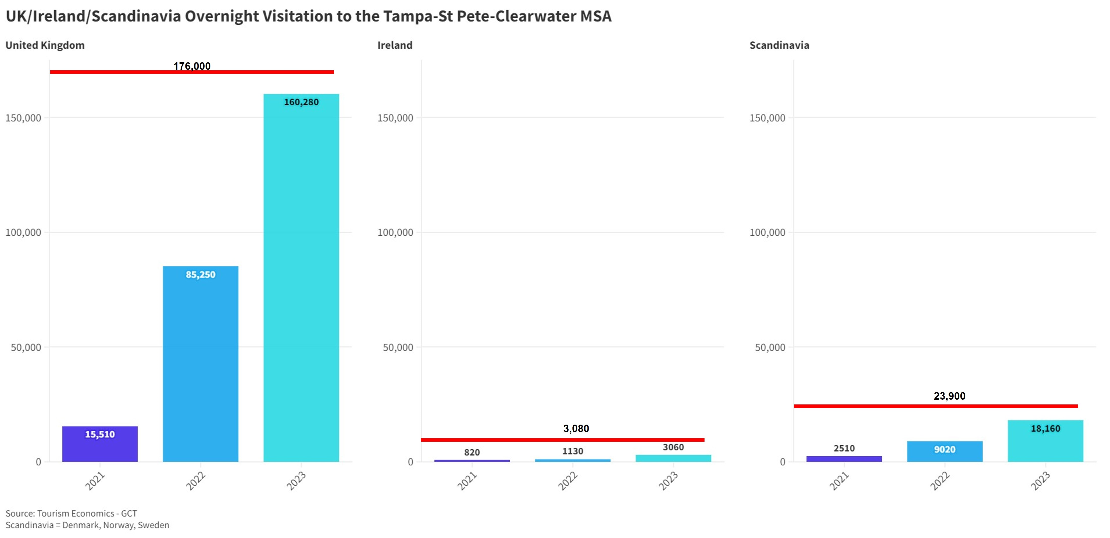

Slide 15
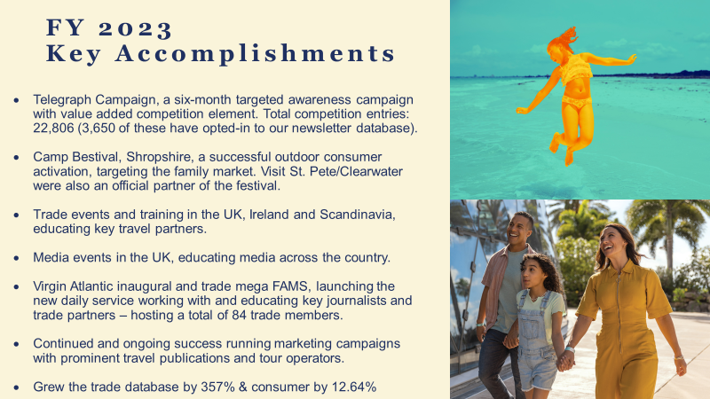

Slide 16


Slide 17
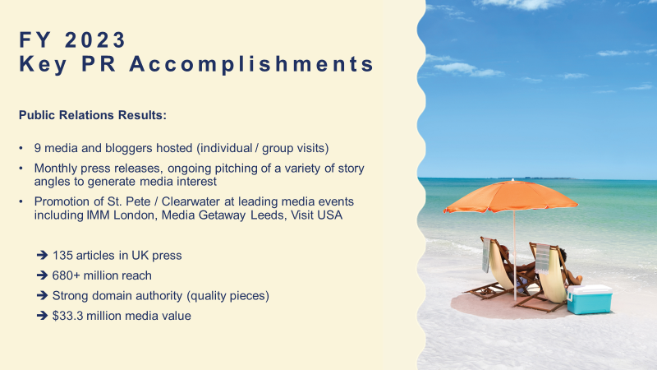

Slide 18
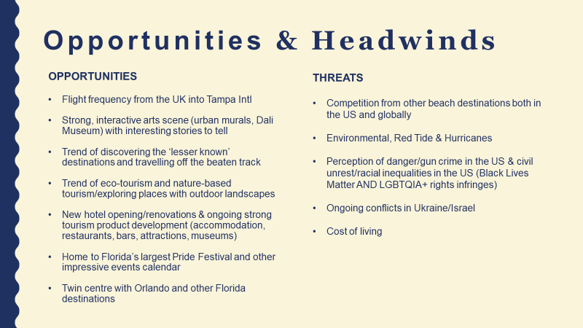

Slide 19
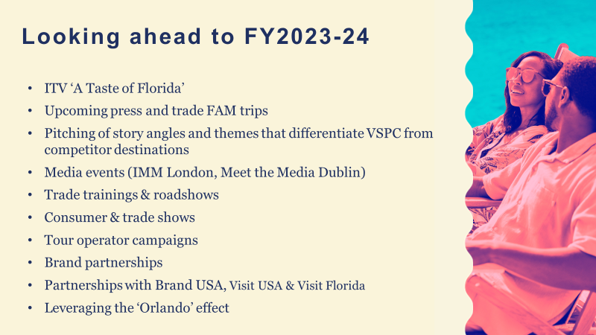

Slide 20
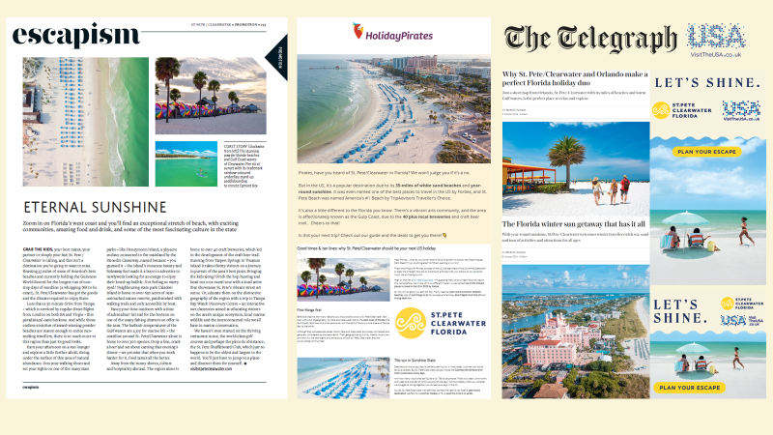

Slide 21
Central Europe Update

Slide 22
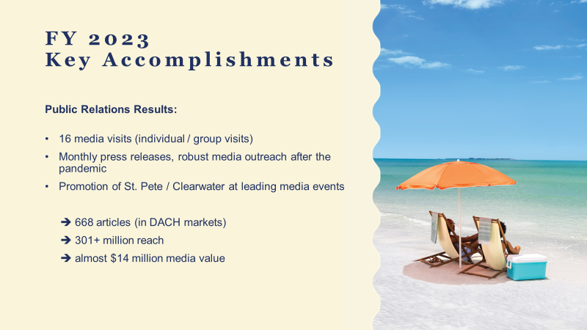

Slide 23
FY 2023
Key Accomplishments
Marketing & Sales Activities in nine European countries:
B2C promotions with leading tour operators
Face-to-face training of 900+ travel agents
Promotion of St. Pete / Clearwater at about 30 leading trade shows and industry events (B2B and B2C)
Hosted 32 top travel agents and tour operators from Germany, Switzerland and the Netherlands in our area
One month long complimentary promotion of St. Pete / Clearwater in 700 McDonald’s restaurants resulted in 35 million consumer contacts (media value: $2.65 million)

Slide 24
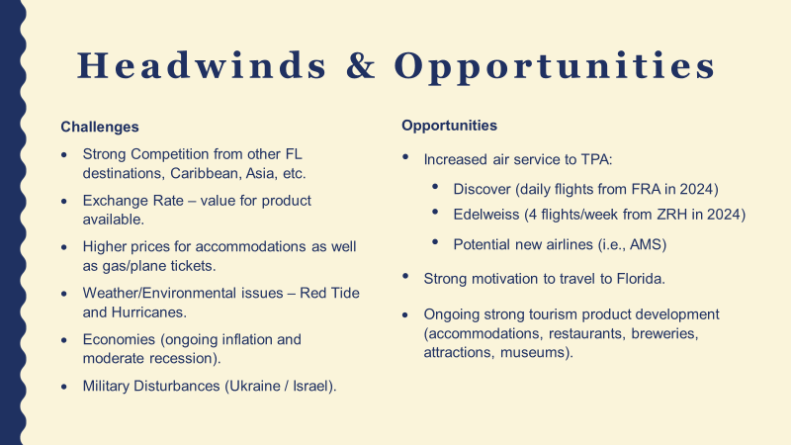

Slide 25
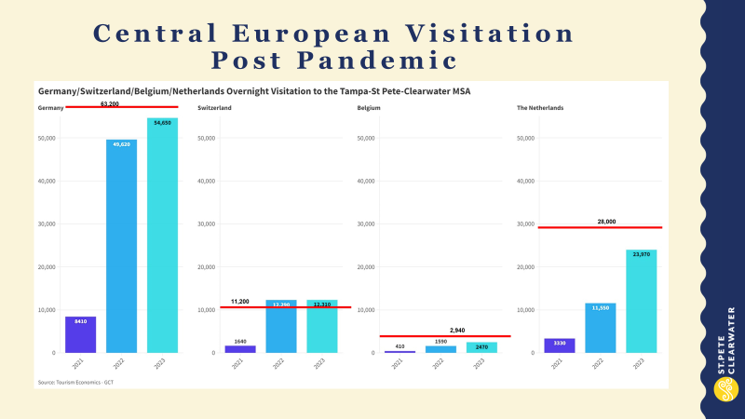
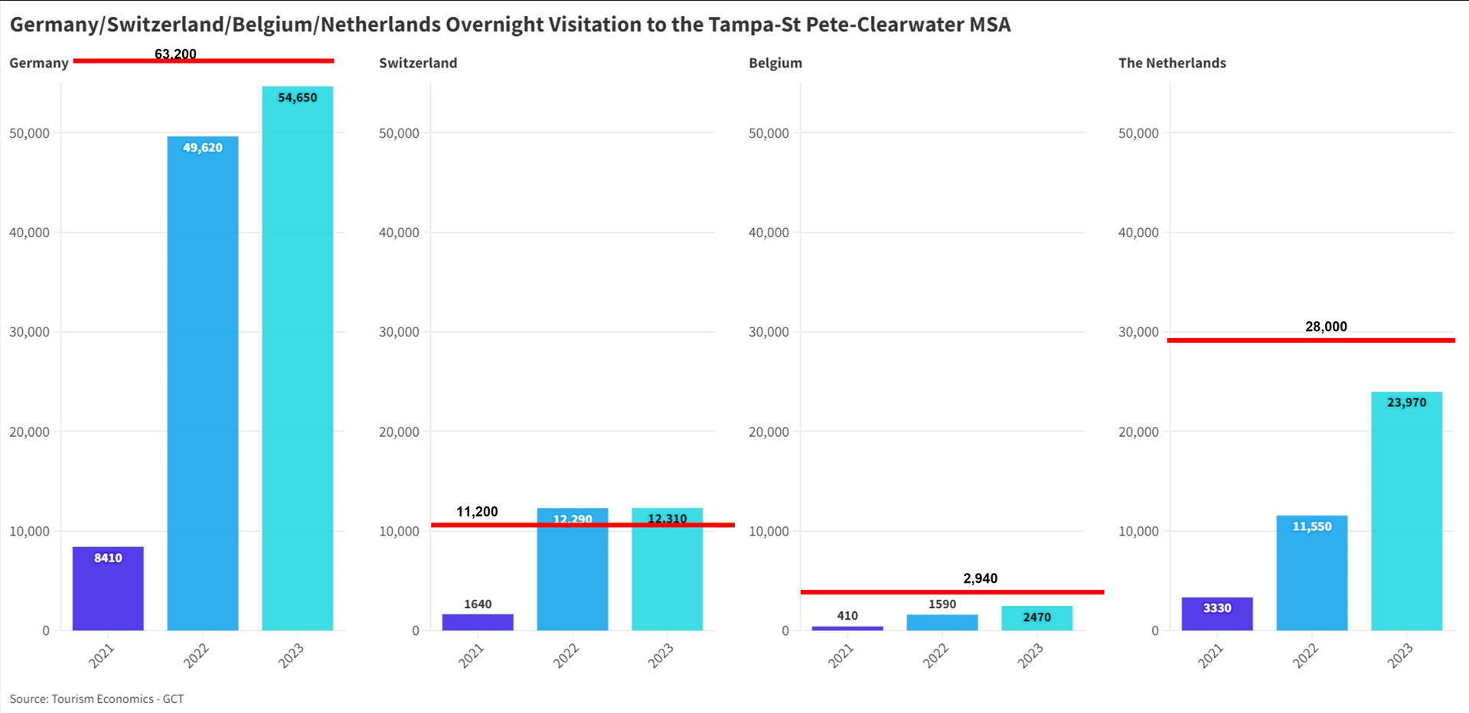

Slide 26
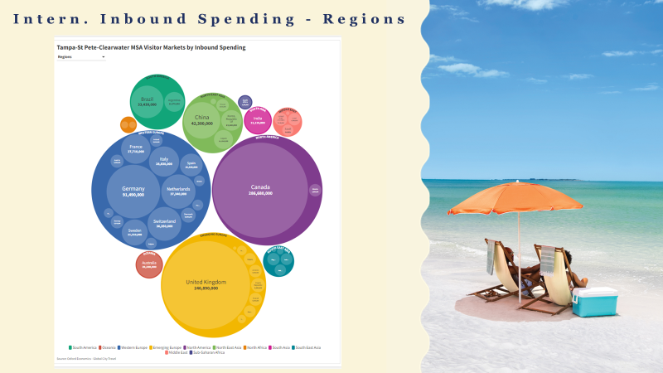
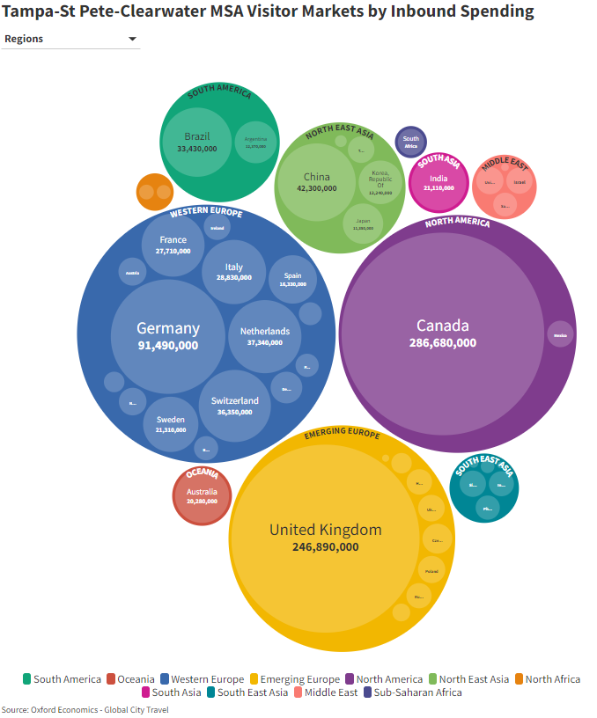

Slide 27
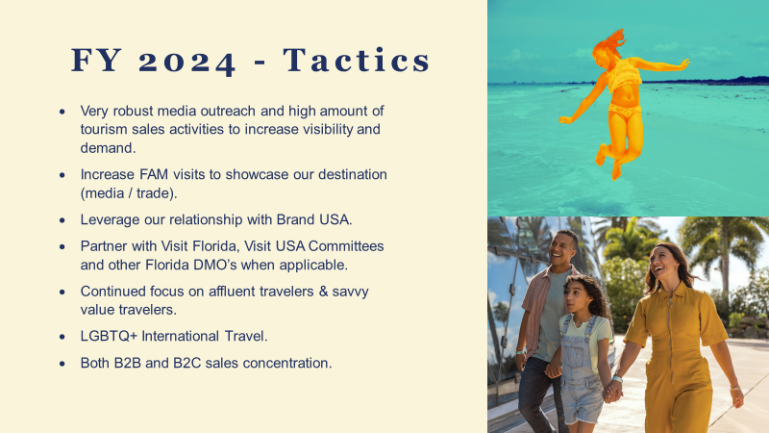

Slide 28
Thank You

