Slide 1
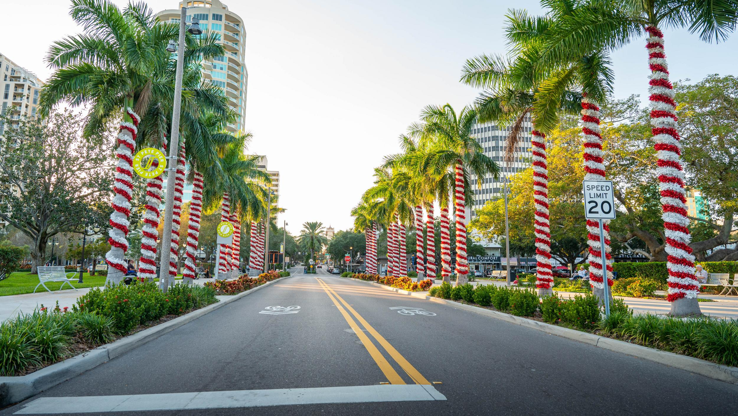
Destination Metrics December 2023
Notes:
Update Slide to November

Slide 2
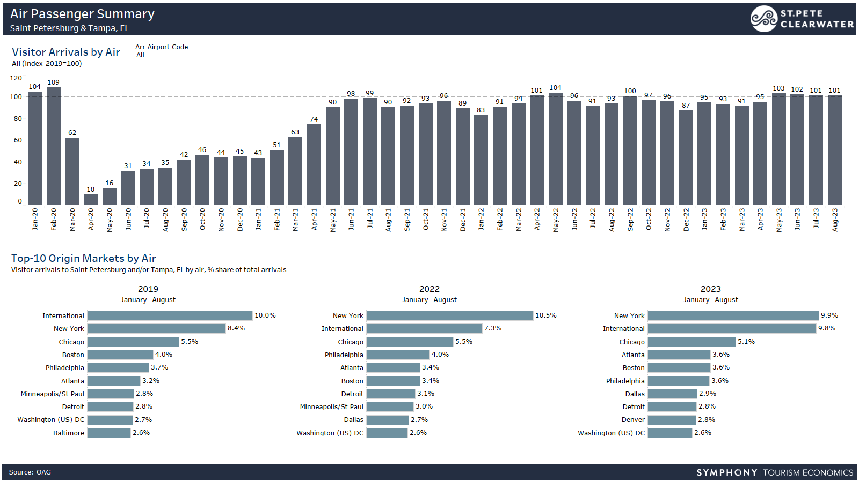
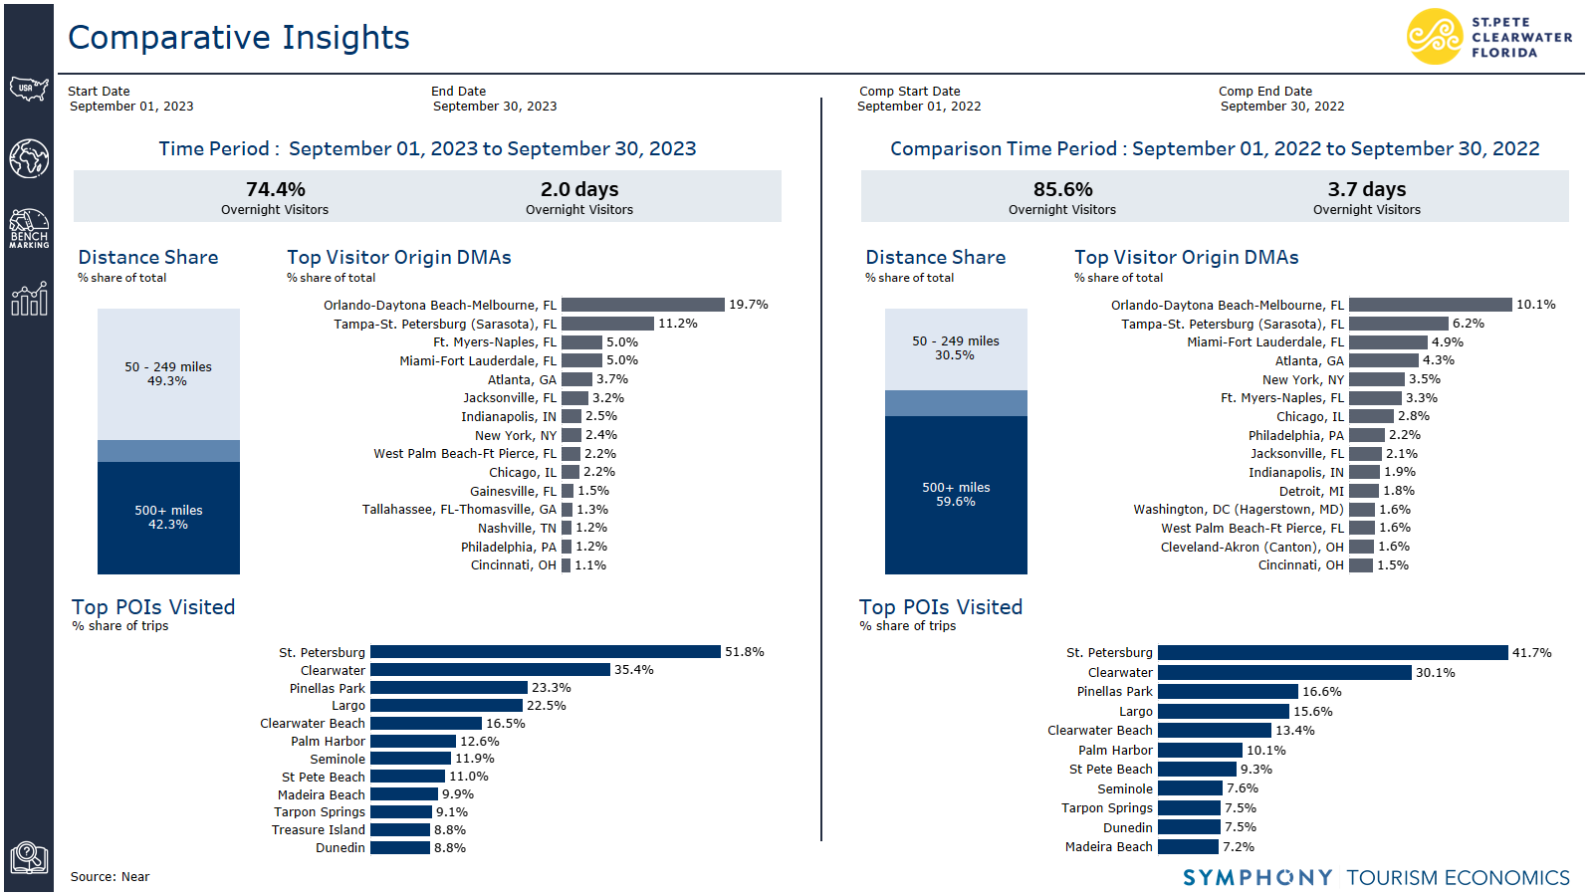
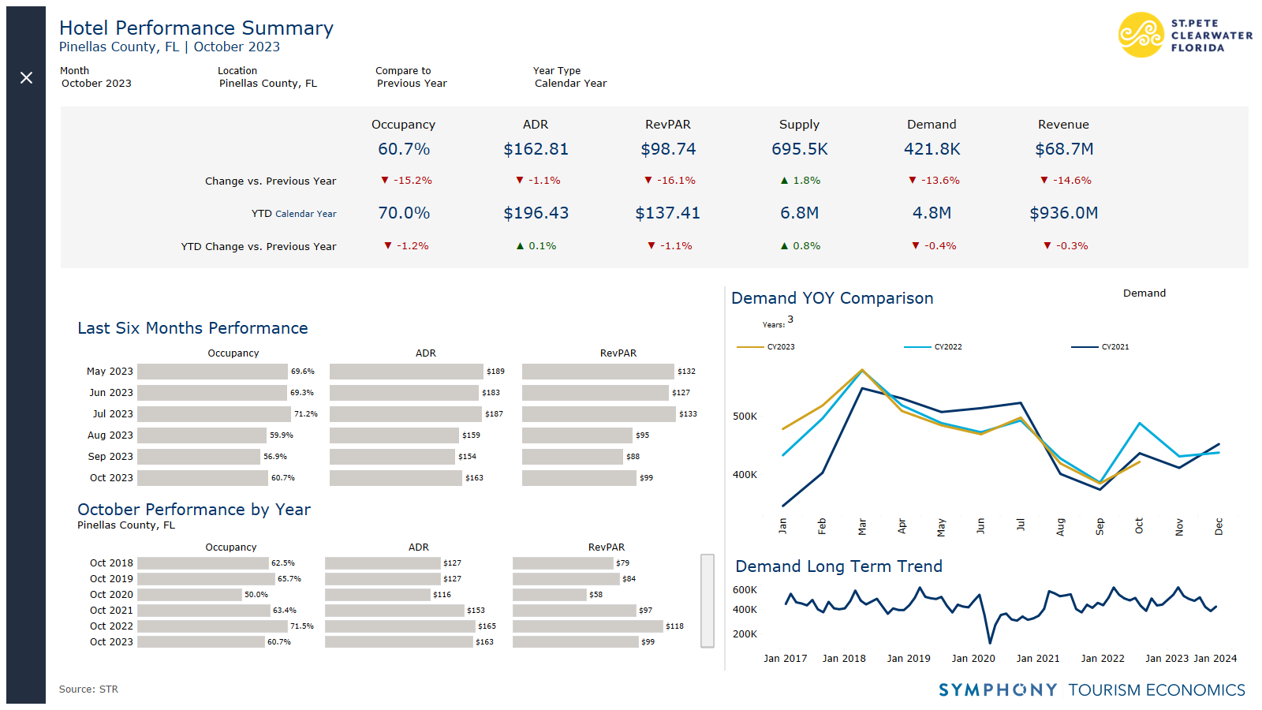
New! Symphony Data in Destination Metrics
Tool Overview
Symphony dashboard tool allows VSPC Team better access to data in one place.
What’s Changing in This Report
Standardized display
New sources included
More department metrics in report
Notes:
Update 6-9 with new slides

Slide 3
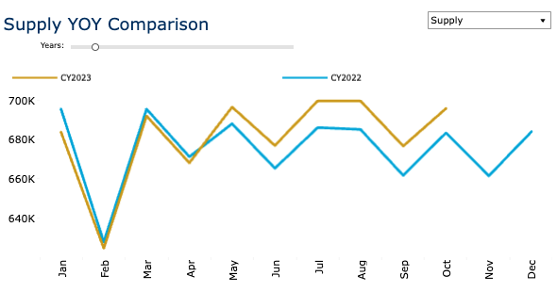
Monthly STR Snapshot: October 2023
Notes:
Update 6-9 with new slides

Slide 4
Year-to-Date Trends
Takeaway
October 2022 saw abnormal increase in travel due to Hurricane Ian.
This benefited Pinellas County in both October and November last year.

Slide 5
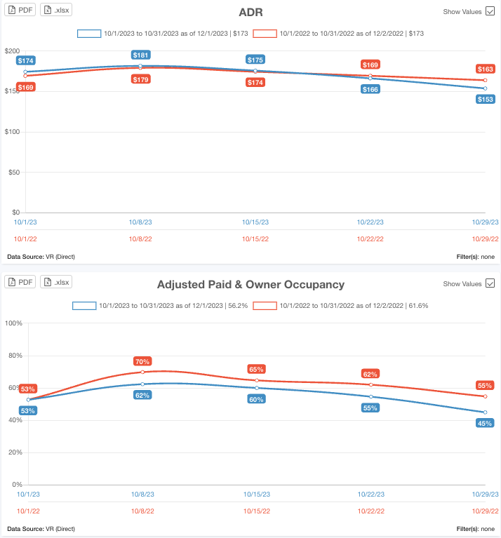
Short-term Rental
Takeaway
Similar trends as hotel data reflected short-term rental data provided by Key Data
32 properties reporting 2666 active units

Slide 6
TDT Collections
Gross Tax | 2020 | 2021 | 2022 | 2023 | 2024
October Collections | $4.1 million | $3.5 million | 5.9 million | $6.5 million | $6.0 million
Takeaway
TDT Collections down from last year due to Hurricane Ian
However, numbers are in line with post-pandemic boon

Slide 7
Traveler Sentiment State of the American Traveler, Future Partners October 2023

Slide 8
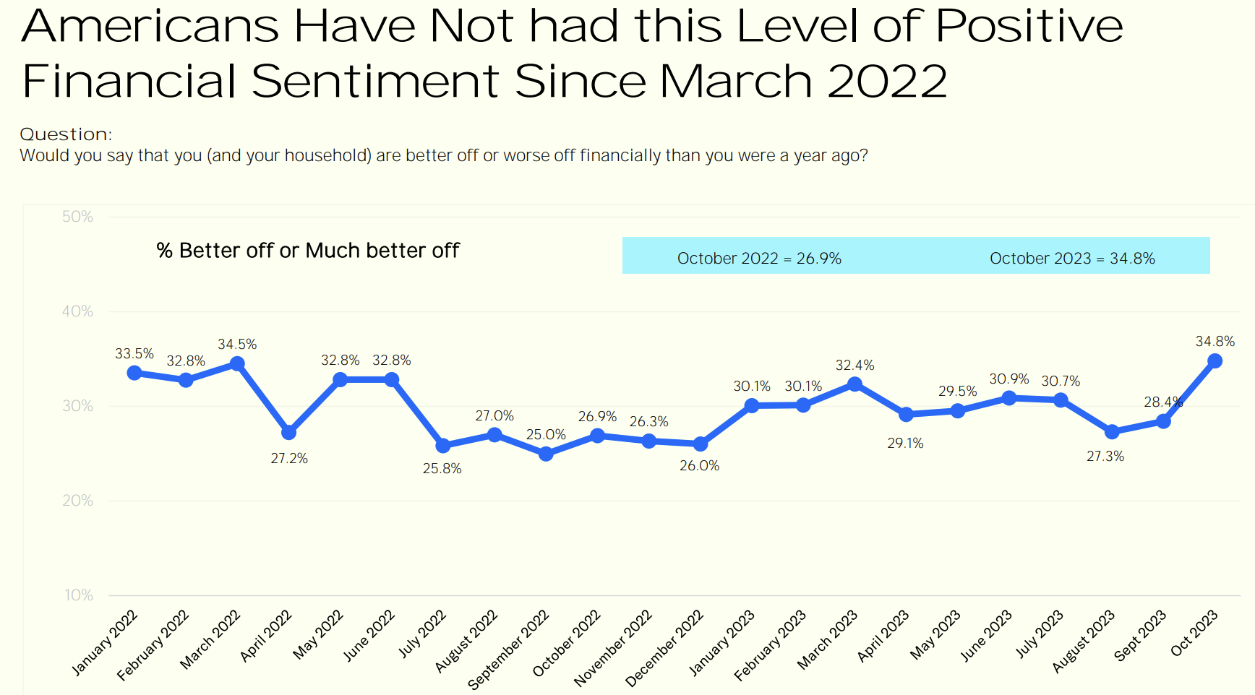
Current Financial Sentiment
Notes:
Update 6-9 with new slides

Slide 9
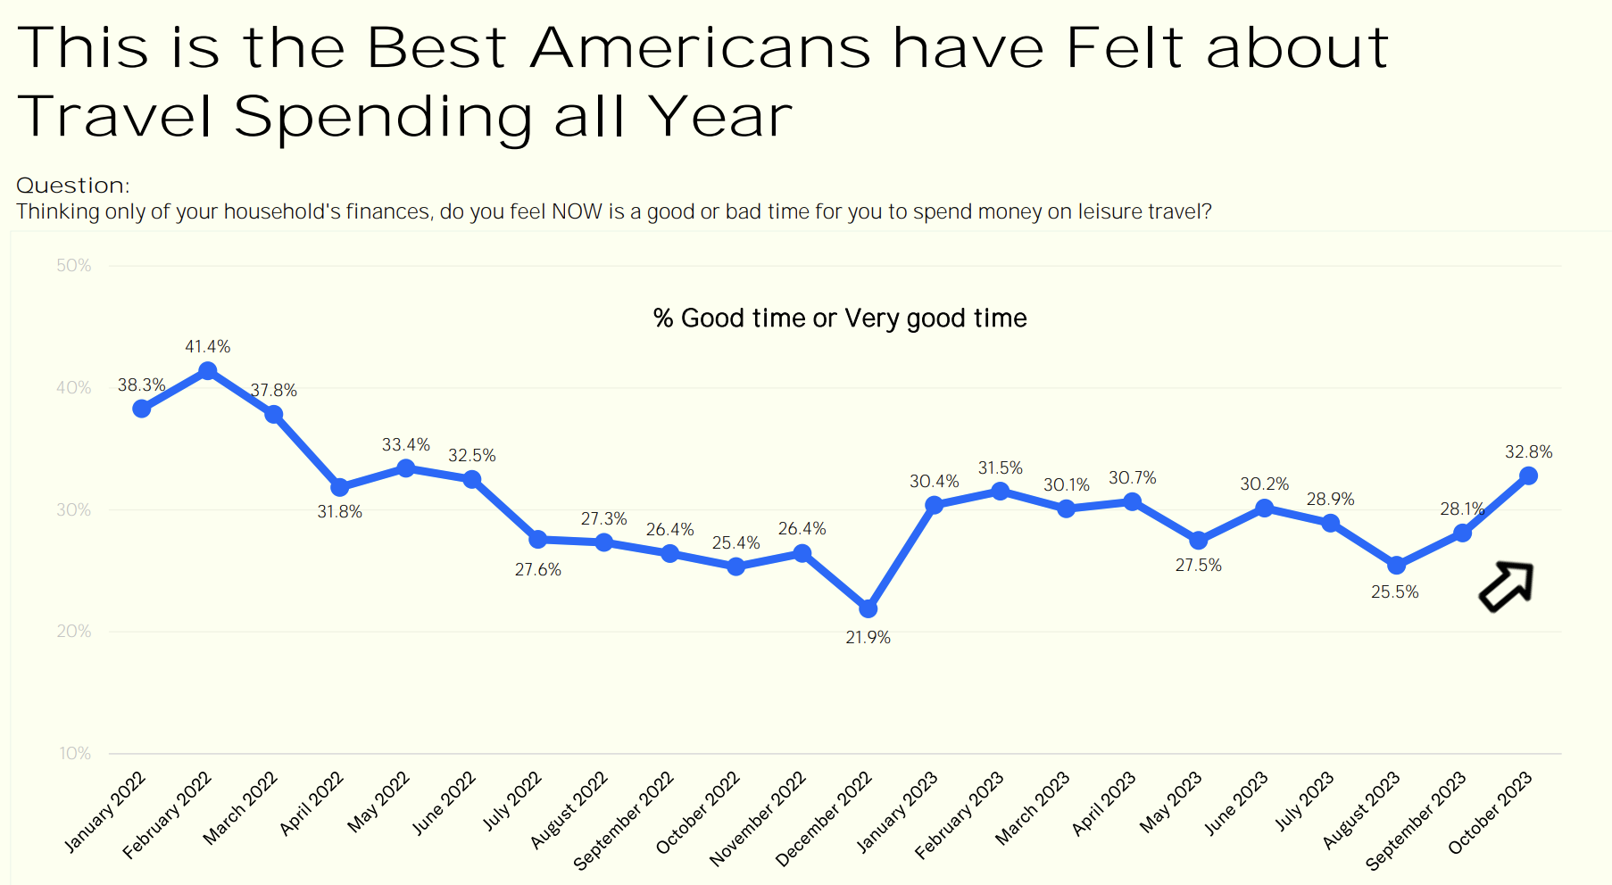
Current Travel Sentiment

Slide 10
Expected Travel Spend

Slide 11
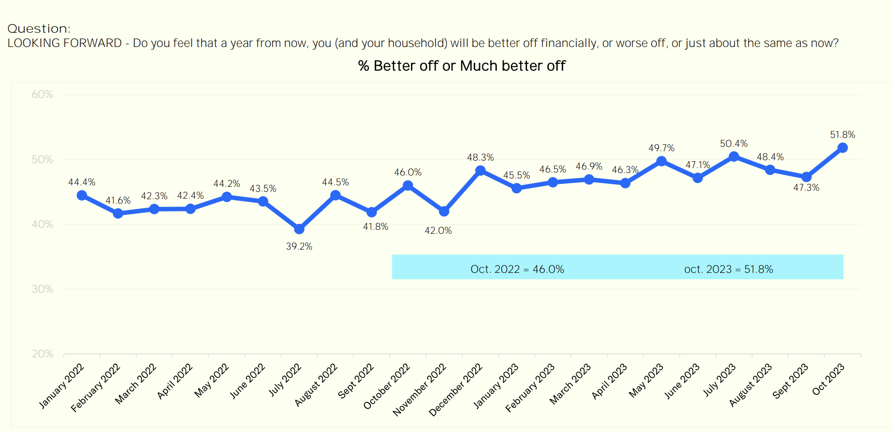
Future Financial Optimism

Slide 12
Holiday Trips
Notes:
Ask about 11 point scale

Slide 13
Visitor Profile Snapshot Future Partners, September profile

Slide 14
September Trends
Decision Time to visit decreased by one week – from 55.4 days to 48.3.
Average Travel Party and Daily Spending size was smaller than 2022, but on par with 2021.
Daytrip visitors increasingly tend to be older. The average age of the daytrip traveler surveyed in 2022 was 8 years younger than in 2023.
Daily spend tends to be at or above 2021 levels for both day trippers and visitors, but reported average income remains below both 2022 and 2021.
Notes:
Remove average days and nights

Slide 15
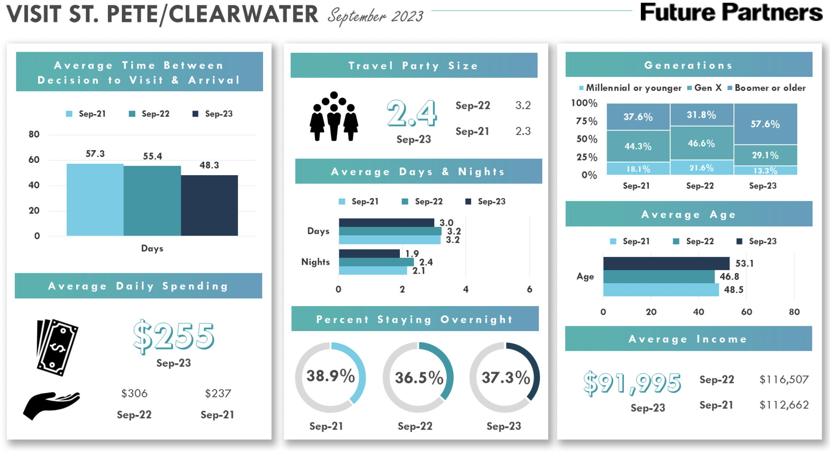
September 2023 Visitor Profile
Notes:
Swap Arrival Method with days and nights

Slide 16
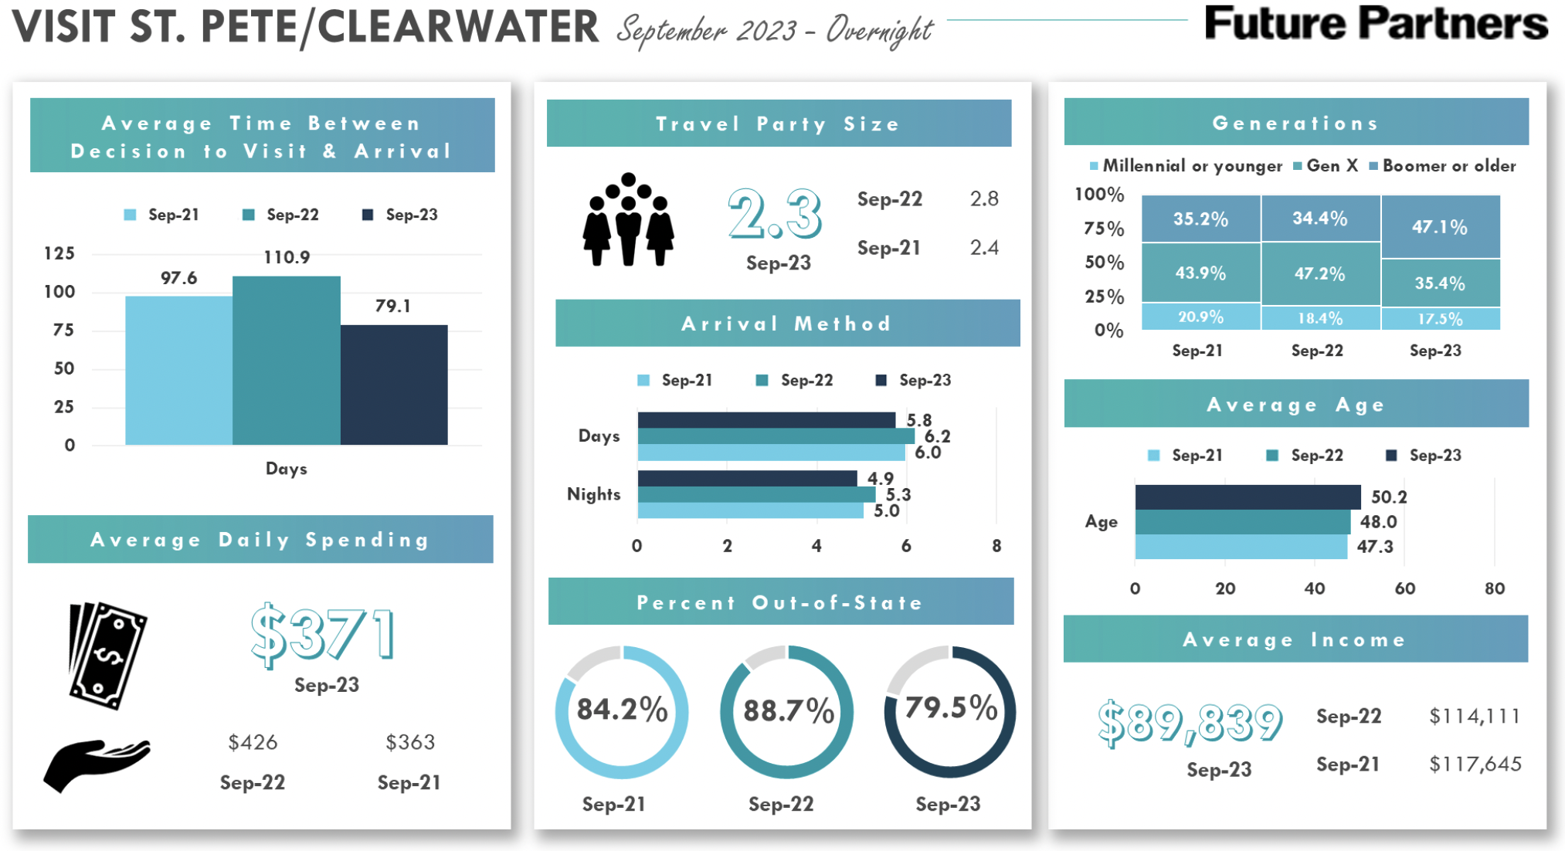
September 2023 Visitor Profile - Overnight
Notes:
Questions about Arrival Method

Slide 17
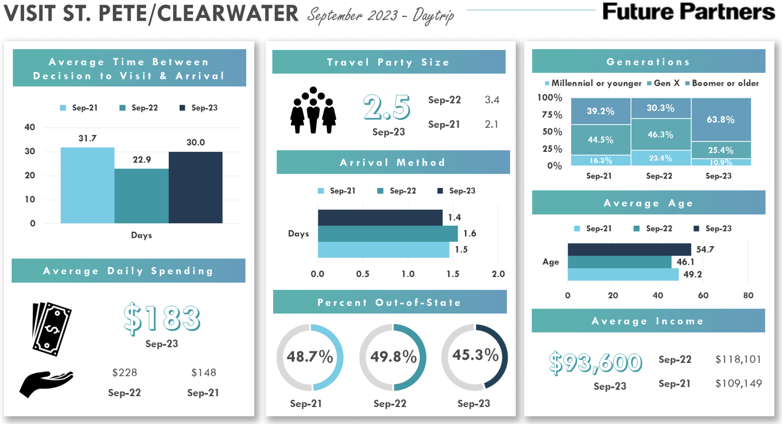
September 2023 Visitor Profile - Daytrip
Notes:
Questions about Arrival Method

Slide 18
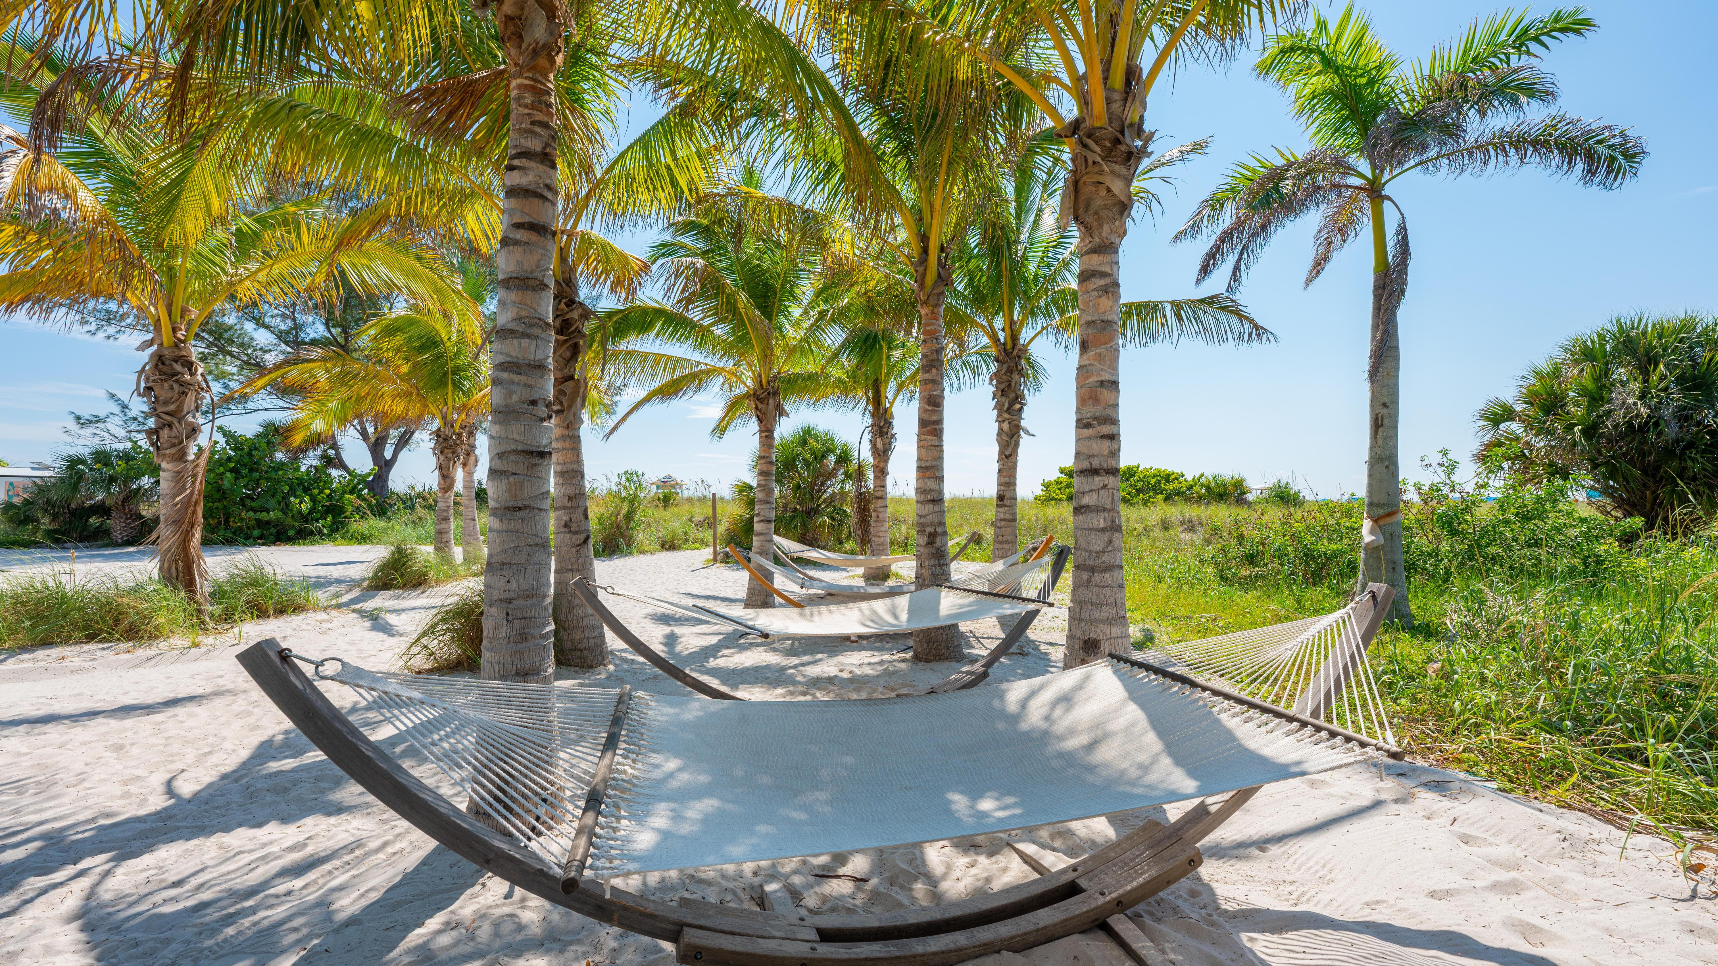
Thank you!

