Slide 1
SPORTS & Events
September 2023
Prepared By: Caleb Peterson, Sr. Manager

Slide 2
September Overview
Hosted 9 events in September:
11,489 overnight visitors
$5,663,878.87 in direct economic impact
9,642 room nights

Slide 3
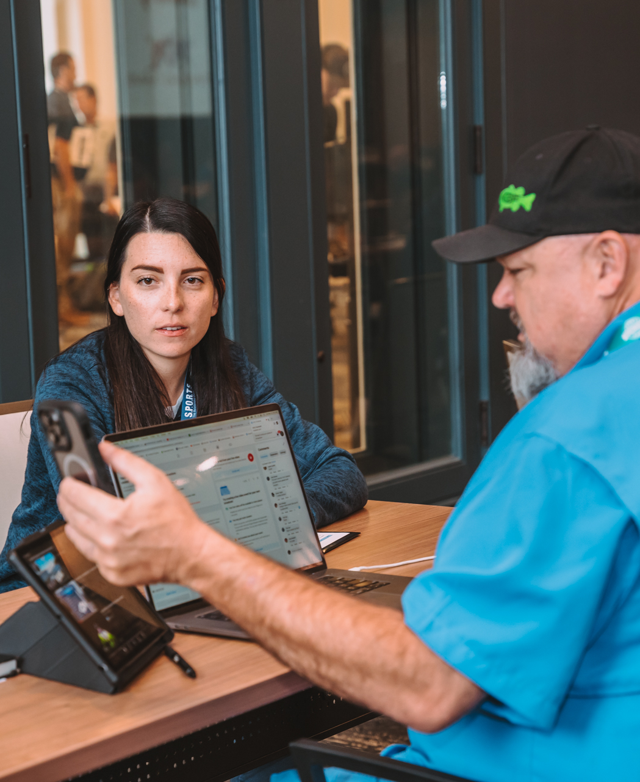
S.P.O.R.T.S. The Relationship Conference
Location: South Bend, IN
Dates: September 11-14, 2023
Staff Member: Andrea Perla
Summary: Considered the #1 conference for building sports industry relationships, VSPC had 13 scheduled appointments with sports event organizers.

Slide 4
Florida Women’s Hockey League Tournament
Organizer: Florida Women’s Hockey League
Venue: Clearwater Ice Arena
Dates: September 8-10, 2023
Market Segment:
Hockey
Impact:
339 Total Attendees
275 Overnight Visitors
434 Room Nights

Slide 5
Year to Date
(10/1/2022 – 9/30/2023)
Hosted 124 events:
180,667 overnight visitors
$133,966,045.15 in direct economic impact
181,365 room nights

Slide 6
Thank you

