Slide 1
THE WOODSON
AFRICAN AMERICAN MUSEUM OF FLORIDA

Slide 2
Our Story
The Woodson African American Museum of Florida - formerly known as The Dr. Carter G. Woodson African American Museum - celebrates more than a decade-long history.
The building was originally the rental office and community center for St. Petersburg’s first African American developed public housing community - Jordan Park - which was constructed in 1939.
After a major reconstruction of Jordan Park in 2006, the former community center was repurposed as a museum and named in honor of the father of African American history, Dr. Carter G. Woodson. Fondly referred to as The Woodson, the museum’s mission to preserve, present and interpret African American history and its culture has garnered a broad audience including community partners, members, volunteers, and friends.
Approximately seven years ago the St. Petersburg Housing Authority proposed the sale of The Woodson’s building. To protect and conserve this important element of the community’s history, the Mayor, with the unanimous support of City Council, approved the purchase of the museum by the City of St. Petersburg.
Since its inception, The Woodson has maximized its modest space, providing some of the most robust programming in the Southeast United States.
Prior to the opening of the National Museum of African American History and Culture, The Woodson was named as one of 17 “must see” museums in the nation.

Slide 3
Serving as a bridge and gateway for safe, constructive, and meaningful discussions regarding history, culture, race, equity and empowerment, The Woodson brings individuals together from all walks of life to inspire and enlighten those who seek to learn more about the rich untold or rarely celebrated stories and contributions of African Americans.
The Woodson’s programming includes popular and well-curated programs, exhibits and events. The space is consistently filled to capacity for concerts, book readings, discussions, and other cultural encounters. Because the building was not constructed to serve as a museum, there are limitations in housing and exhibiting collections because it does not meet necessary standards such as security, UV, and humidity requirements.
The Woodson’s growth and popularity has outgrown its current single story 4,000 square foot facility. Event after event, visitors are being turned away due to limited accommodations. The Woodson experiences overflow attendance by locals, as well as visitors who arrive from outside the city and state on chartered buses.
The African American cultural experience is highly sought, and The Woodson has become the community’s epicenter for music, dance, theater, visual art, film, arts education programs, literature, and community outreach. A solid track record has been established to justify the need for expansion to include more programs, event space, and art exhibits.
The board and community leaders have engaged in focus groups, round table discussions, and one-on-one discussions with museum directors, funders, business leaders, artists, and community stakeholders as part of the process to carefully consider the next natural step for The Woodson. With a desire to stay true to the culture represented, board members and friends of The Woodson have explored ways in which the museum might expand and create a first-class African American Museum for our county, state, and nation.
We invite and welcome you to be a part of The Woodson African American Museum of Florida.

Slide 4
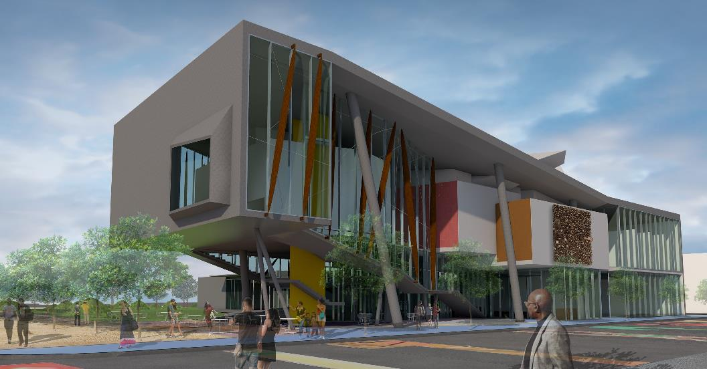
South facing view of Front of the Museum from 22nd Street South. The new 30,500 square foot museum will activate 22nd Street South and set the tone through its form, that this is an iconic treasure housing an important cultural experience.

Slide 5
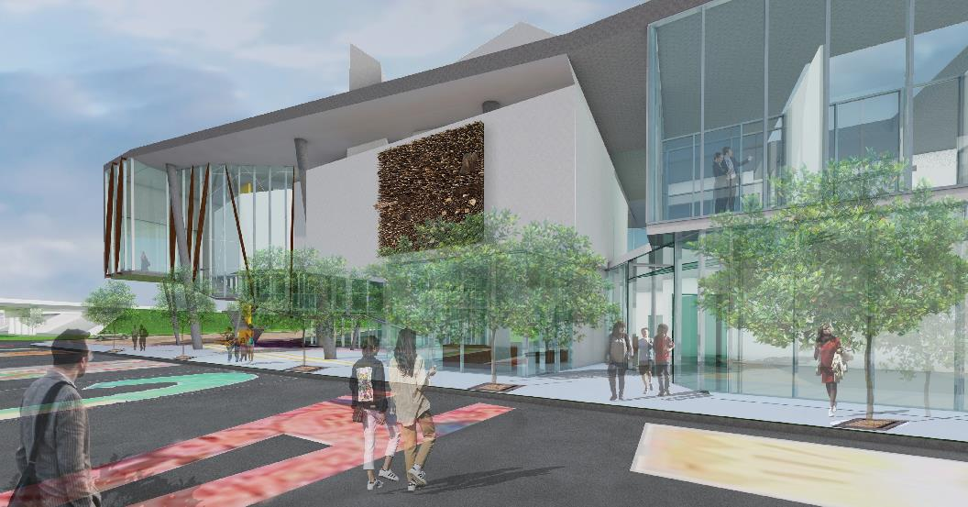
The view of the Front of the Museum, facing southwest on 22nd Street South. A multi-functional education space, The Justice Center, is accessible directly from the lobby as well as from 22nd Street South. The Justice Center can be viewed in this rendering on the far right of the first level.

Slide 6
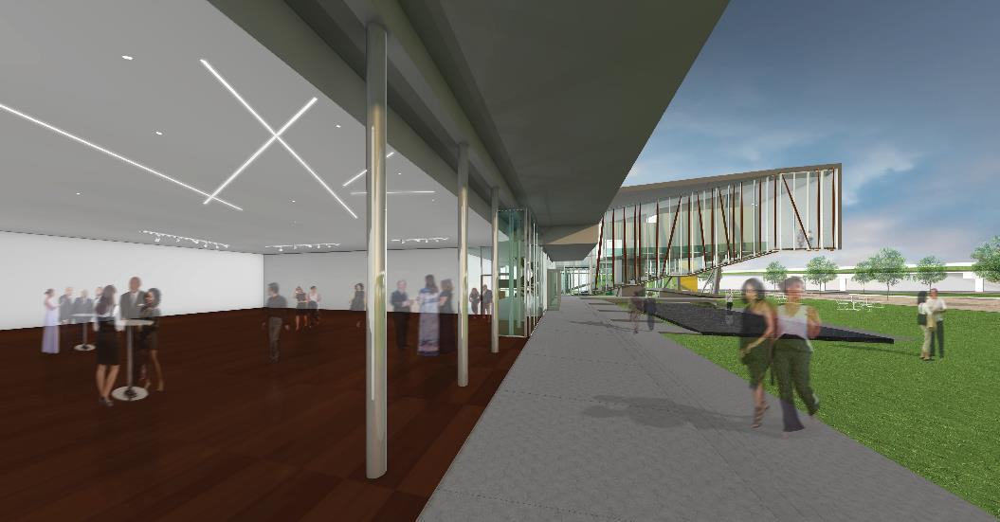
View from the southwest into the Forum event space with the sliding doors open to the exterior Celebration Lawn, Water Table, and Sculpture and Healing Garden. The Forum will allow The Woodson to function as a profit center with event space for weddings, special parties, for-profit company meetings, and non-profit conferences.

Slide 7
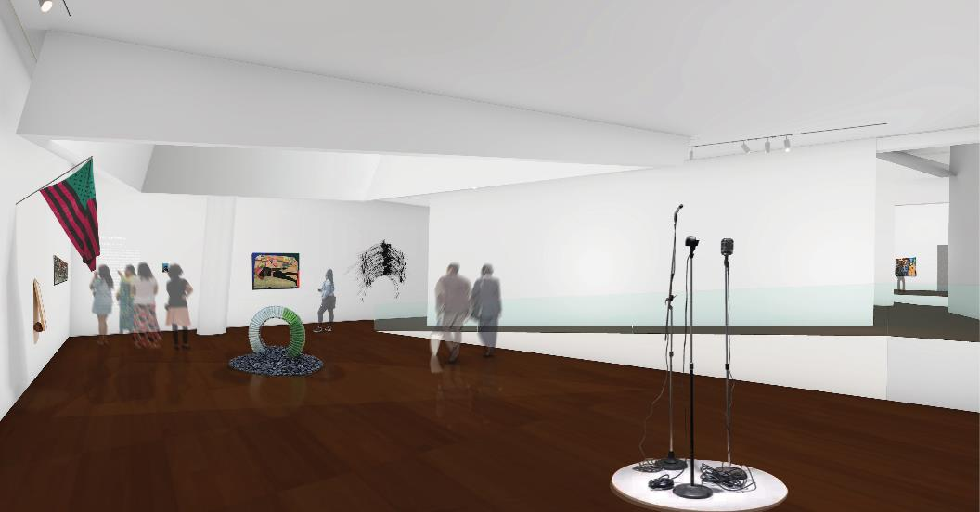
View of one of the three second floor Galleries. The Woodson is a member of the Association of African American Museums. The gallery will allow for a stunning mix of long-term site-specific exhibitions and a dynamic exhibition program from the Smithsonian Traveling Exhibition Services and other museums.

Slide 8
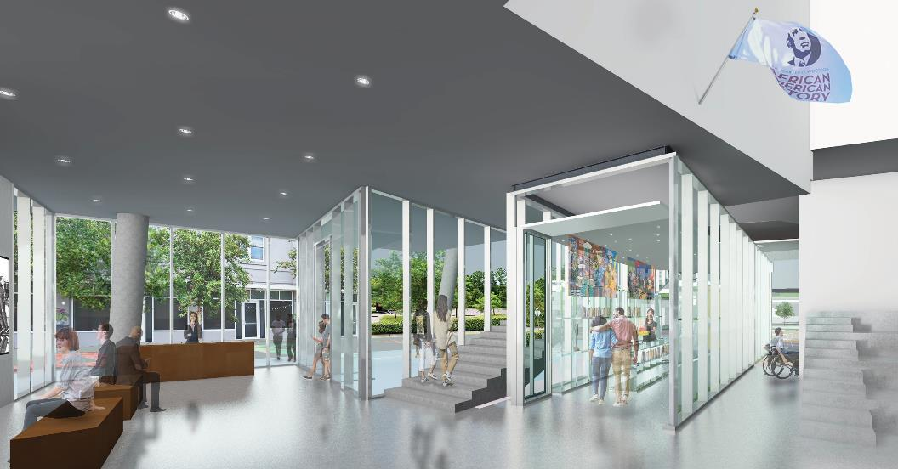
View of the entrance to the Gift Shop and Visitor’s Center. The Gift Shop is located on the street level and can be accessed without entering the Museum. The Visitor’s Center will provide a unique service proposition (USP) with our ability to assist in acquainting our visitors with the African American Heritage Trail and other significant cultural experiences within the larger community.

Slide 9
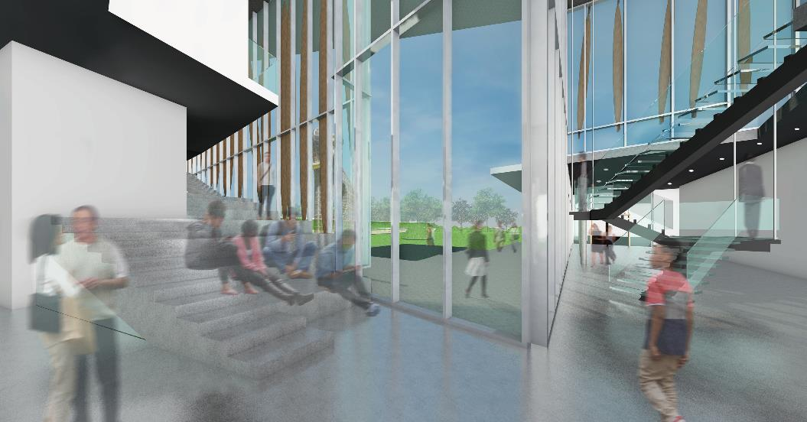
View of the stairs and Small Amphitheatre next to the entrance that leads to the second floor of the museum. The stairs are designed to also be used as a flexible seating space for student lectures, small concerts and other gatherings.

Slide 10
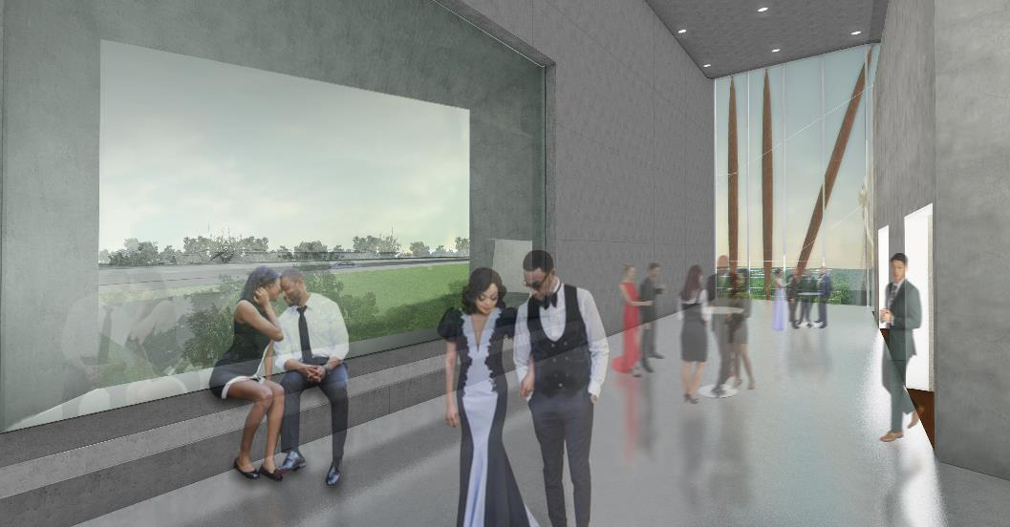
Interior view from the second story Loggia, looking out over I-275 and toward Jordan Park. This is a special space in the museum and easily used for receptions and special events.

Slide 11
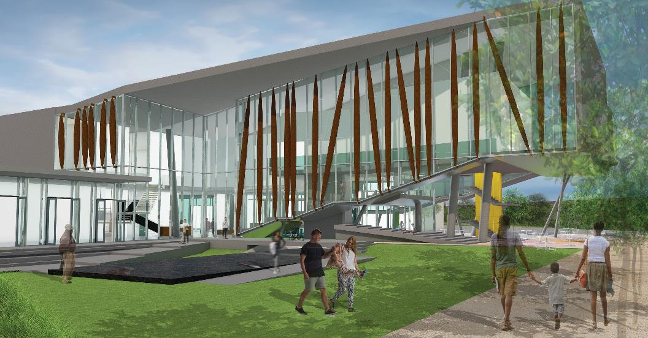
South view looking north over the Water Table and Celebration Lawn. Surrounding this beautiful space is the Sculpture and Healing Garden (not shown in this rendering).

Slide 12
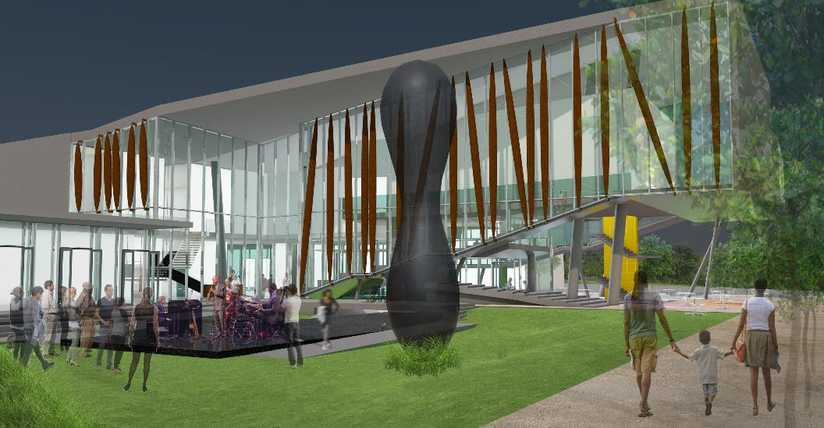
The Water Table is a flexible use venue on the museum campus. The water can be shut off, and the Water Table used as a stage for concerts, weddings, and other celebrations.

Slide 13
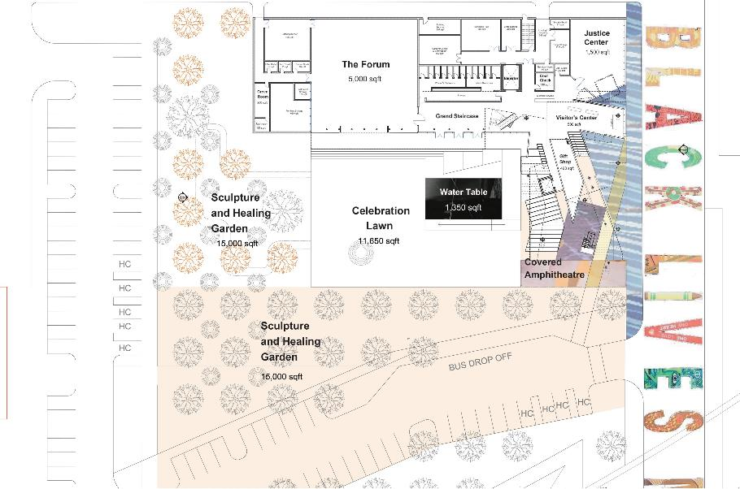
Aerial View of gardens and first level museum.

Slide 14
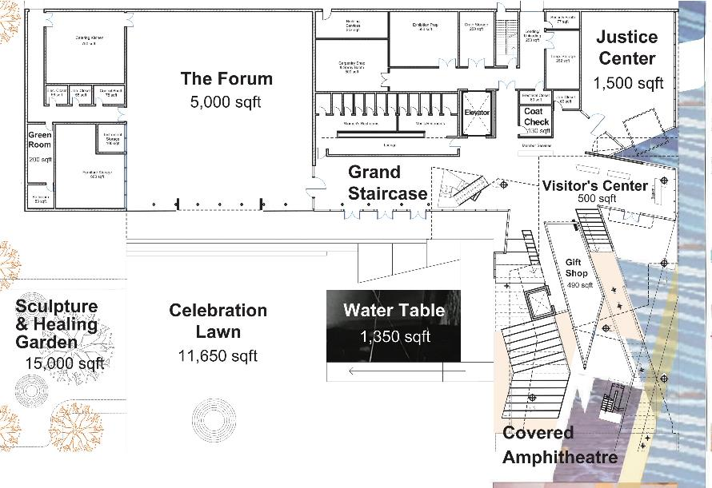
1,200 sqft
Close-up of first level museum.

Slide 15
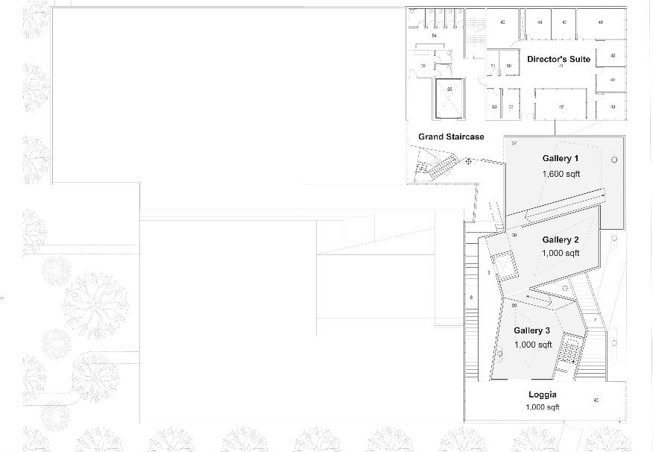
2,173 sqft
Aerial View of second level museum.

Slide 16
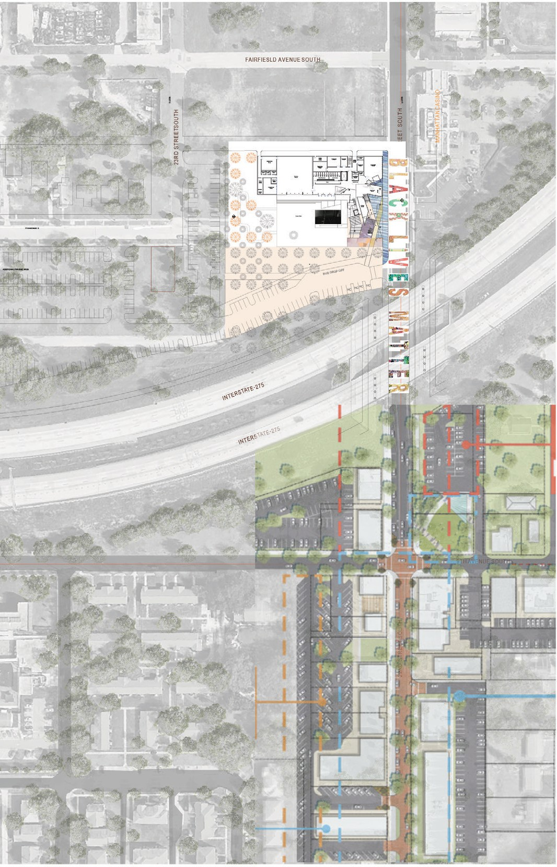
Aerial View of The Woodson museum site. The anticipated budget, including, design, construction and 3 years operational costs for The Woodson project is $26,500,000.

Slide 17
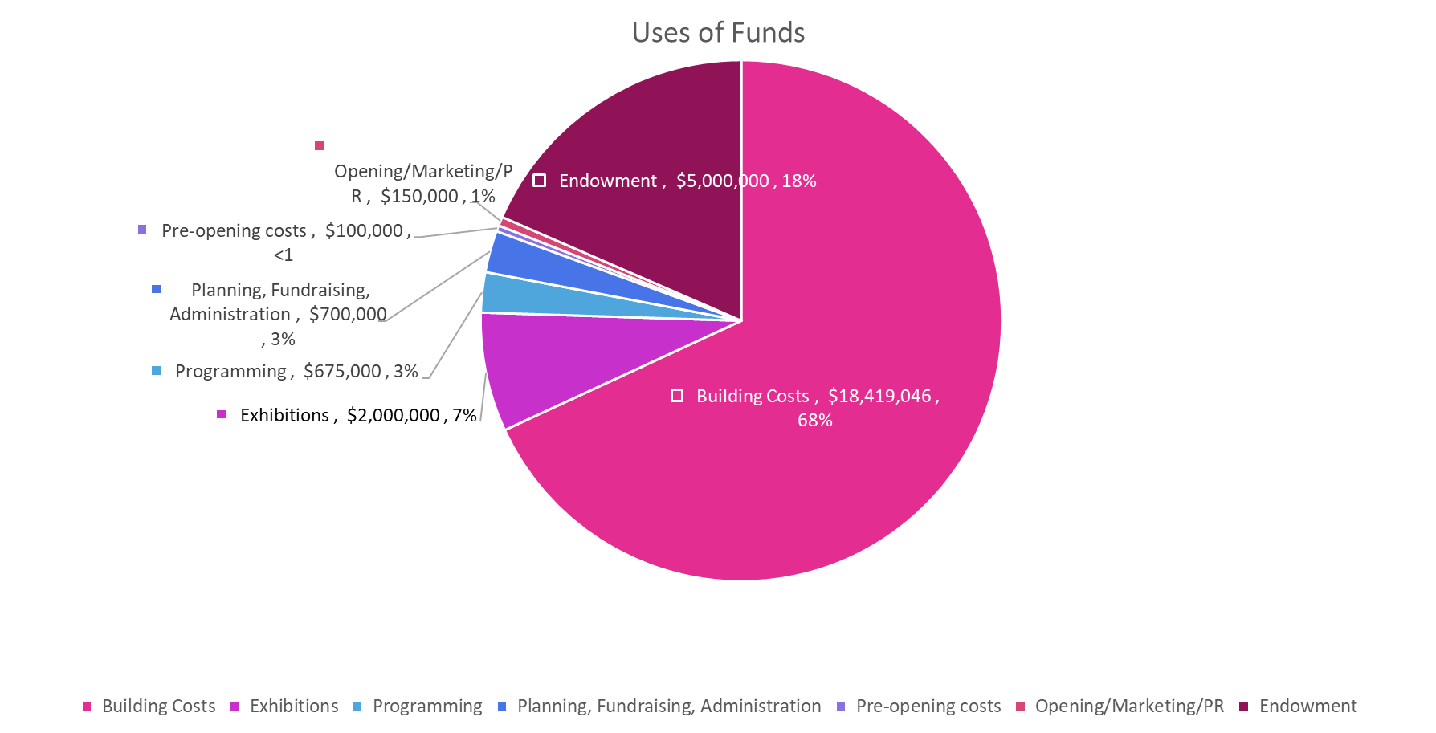
The capital campaign budget is $26.5M: includes $18.5M build, design, construction; $5M endowment; and $3M for three years operational costs.

Slide 18
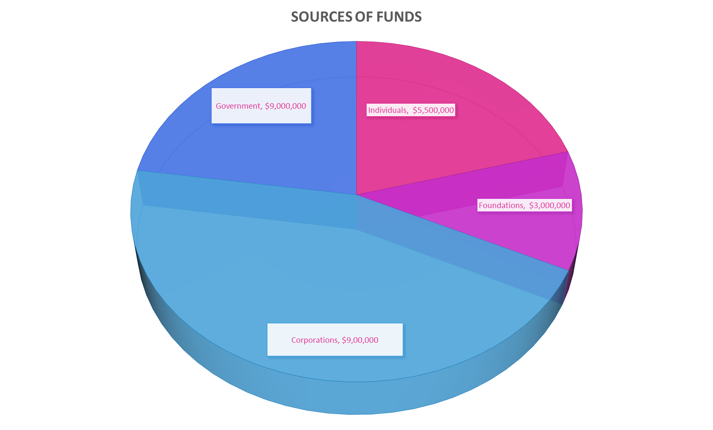
The capital campaign anticipated Sources of Funds: $9M Government; $5.5M Individuals; $3M Foundations; $9M Corporations.

Slide 19
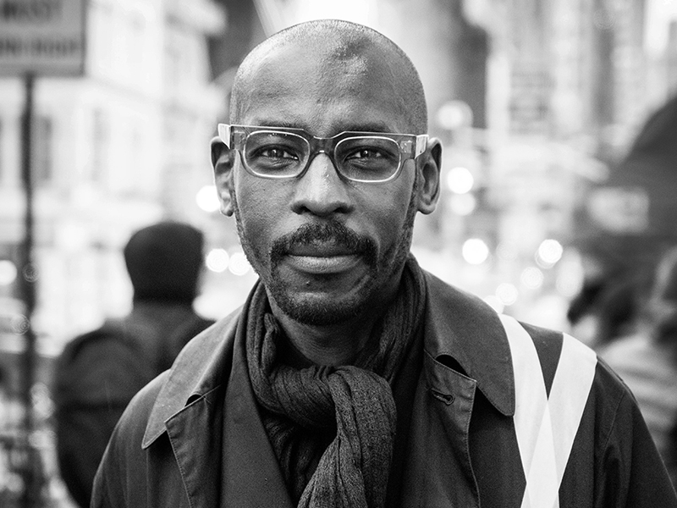
Design Architect
Mario Gooden, AIA, B.S., M.Arch Huff + Gooden Architects
Mario Gooden is a cultural practice architect and founding principal of Huff + Gooden Architects. Gooden is also a Professor of Practice at the Graduate School of Architecture Planning and Preservation (GSAPP) of Columbia University where he is the co-director of the Global Africa Lab (GAL). He teaches advanced architectural design and theory at Columbia University.
Gooden is a 2012 National Endowment for the Arts Fellow, a MacDowell Fellow, and a 2019 National Academy of Arts and Letters Award in Architecture recipient. Gooden is the author of Dark Space: Architecture, Representation, Black Identity (Columbia University Press, 2016) as well as numerous essays and articles on architecture, art, and cultural production. Gooden is Research Associate at the Visual Identities in Art and Design (VIAD) at the University of Johannesburg (South Africa).

Slide 20
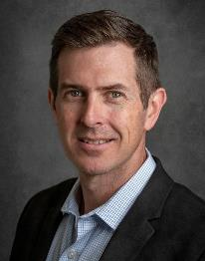
Architect at Large Jason Jensen, AIA, LEED AP
Wannemacher Jensen Architects
Jason Jensen is the President and CEO of WJ Architects, an interdisciplinary architecture firm in St. Petersburg, Florida that specializes in cultural and community focused projects. A University of Florida graduate, Jason began his career in New York before returning to St. Petersburg with the goal of promoting innovative community focused architectural design across Florida.
Recent notable projects include the James Museum, the Pier Approach, and the SPC Student Services building. With each project and any given set of parameters or challenges, Jason strives to provide creative design solutions that promote community and client ambitions, advance creative development, redefine conventions, and generate purpose driven solutions.

Slide 21
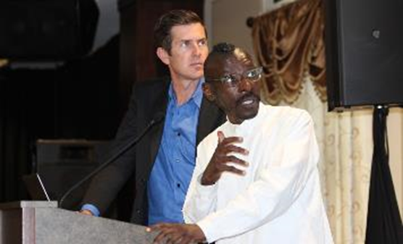
Committee Members:
Duggan Cooley
CEO
Pinellas Community Foundation
Leigh Davis
Director of Donor & Advisor Relations
Pinellas Community Foundation
Charlie Gerdes
Partner
Kean, Reese, Vesley & Gerdes, P.A.
Mario Gooden, AIA, B.S., M. Arch
Design Architect
Huff + Gooden
Jason Jensen, AIA, LEED AP
Principal Architect
Wannemacher Jensen Architects
Manitia Moultrie
Principal
Golder Associates
Terri Lipsey Scott
Executive Director
The Woodson African American Museum of Florida
Lorna Taylor
President & CEO
Premier Eye Care
Jason Jensen and Mario Gooden leading community discussions on The Woodson.
Photo credit: The Weekly Challenger
For more information, please contact:
Terri Lipsey Scott
Executive Director
727.434.0777
Lorna Taylor
Co-Chair, Capital Campaign
813.220.1240

